Slide 1
Knowledge Inference
Entity Disambiguation
Label Propagation
Link Prediction
Data Integration

Slide 2
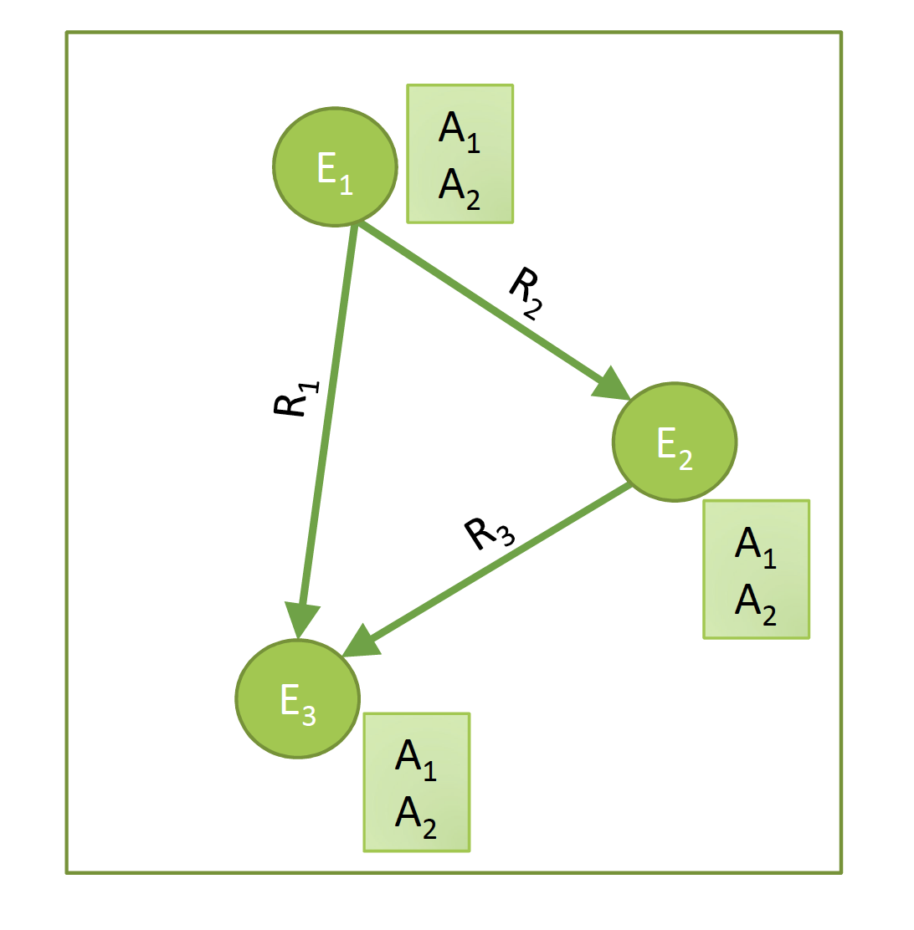
Basic Questions in Knowledge Inference
Who are the entities?
Entity Linking / Disambiguation
Data integration
What are their attributes?
Collective Classification
How are they related?
Link prediction
Notes:
Knowledge inference concerns a wide number of problems that have been studied in many different contexts. Some of the basic examples are:
Entity linking and disambiguation, which concerns the problem of identifying which entity names represent the same real-world entity, respective which entity is referred to in case of ambiguous entity names.
Schema integration, which concerns the problem which classes, attributes and relationships in one knowledge bases correspond to which in another one.
Collective classification, which concerns the problem of learning unknown attribute values from the available knowledge in a knowledge base.
Link prediction, which concerns the problem of learning unknown relationships from the available knowledge in a knowledge base.

Slide 3
1. Entity Disambiguation

Slide 4
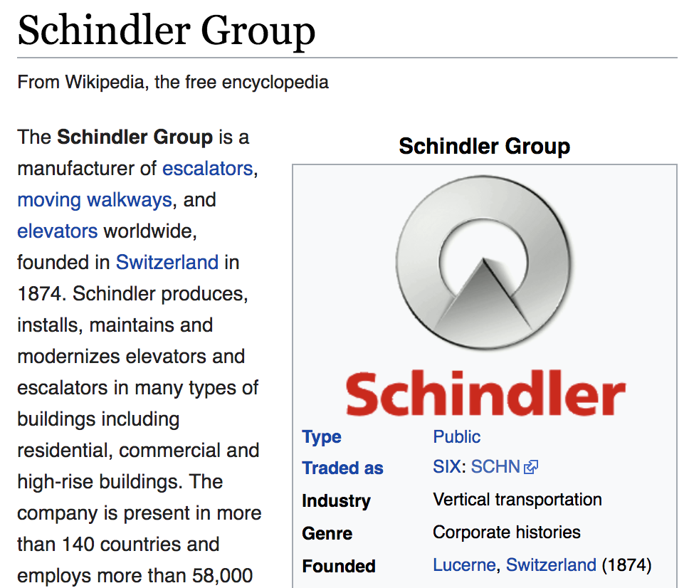
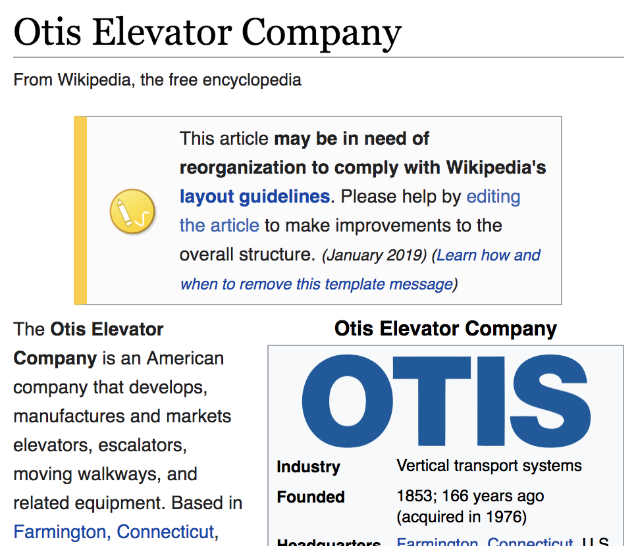
Entity Disambiguation
Task: Link a text mention in a document to an entry in a knowledge base (e.g. WikiPedia or WikiData)
Also called entity resolution and linking
Example: “Schindler is a Swiss industrial company. One of its main competitors is the American producer Otis.”
Notes:
Once entities in a text have been recognized, one would link them to their corresponding counter-parts in a knowledgebase. So entitiy disambiguation is a step that usually follows named entity recognition.

Slide 5
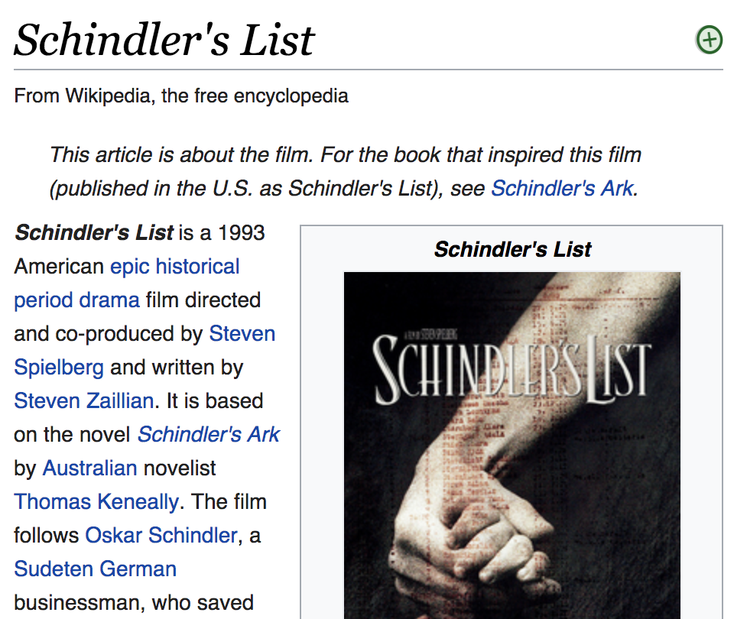
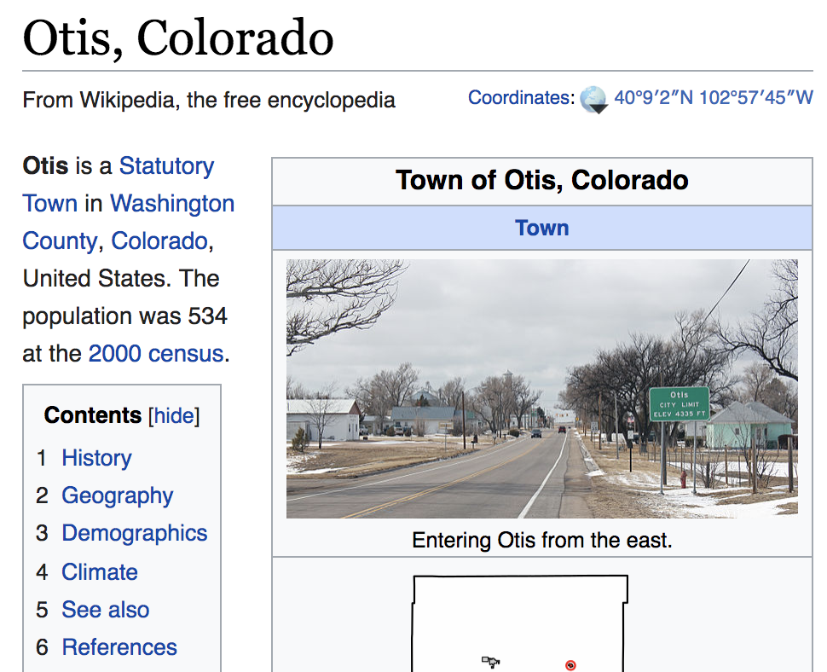
Challenge
Two problems
Homonyms: entities with the same name
Synonyms: different names for the same entity
Notes:
Entity disambiguation can however be quite challenging to the homonymy and synonymy problem. Handling these problems is essential for every text analytics tasks. Not being able to handle homonymy usually results in the introduction of noise into the results (poor precision) whereas not properly handling synonymy risks to miss relevant documents (poor recall).

Slide 6
Sources of Information
Local information: similarity of a text mention of the entity and the data in the knowledge base
Example: “Schindler” ≈ “Schindler’s list”
”Schindler” ≈ “Schindler Group”
Global information: coherence of the different text mentions of potential entities within a document with respect to a knowledge base
→ entity graph
Notes:
For performing entity disambiguation one can exploit two different sources of information. On the one hand local information extracted from the text mention, or its vicinity, can be exploited. This can be used to compare the text mention and its features with the representation in the knowledge base, in order to obtain evidence which entitities in the knowledge base are potentially matched. A second source of information is the knowledge base itself, when multiple entities are mentioned in the same text. Since these entities from the same text are likely to be in some form of relationship among each other, it is likely that such relationships are also discovered in the knowledge base. This can help in entity disambiguation.

Slide 7
Entity Graph
m = “Schindler”
e = (c,m)
?
Schindler Holding
Schindler’s List
“Swiss”
Switzerland
Links in the knowledge base
American
Otis Elevator Company
Otis, Colorado
s = (c’,m’)
?
“American”
Possible interpretations of mention
in the knowledge base
m’ = “Otis”
Notes:
Here we illustrate the basic model of how a knowledge base can be employed for entity disambiguation:
m are text mentions of entities (extracted using NER)
For each mention there are candidates in KB; these can be identified using local information from the text mention
Each is a graph node; we can also associate a similarity measure to each node
Edges between mention-candidate pairs are included if a link exists in the KB among the respective candidates
Since the same text mention can relate to several candidates, the problem of entity disambiguation is to determine which among the multiple candidates is the most likely to be correct.

Slide 8
Coherence
How well does the choice of node s
support the presence of node e?
Other formulation: How relevant is node e for node s?
e
s
Notes:
To perform entity disambiguation, we pose the following question: given a node s in the entity graph, how well does it support the presence of another node e in the graph?
This question is actually related to a question that has been investigated in the context of personalized Web search: given a URL from the personal bookmark list of a user, how relevant is a page in the Web for this user. To answer this question a variation of the PageRank algorithm, which determines general relevance, has been proposed. It is called Personalized PageRank, which determines relevance with respect to a specific node in the graph.

Slide 9
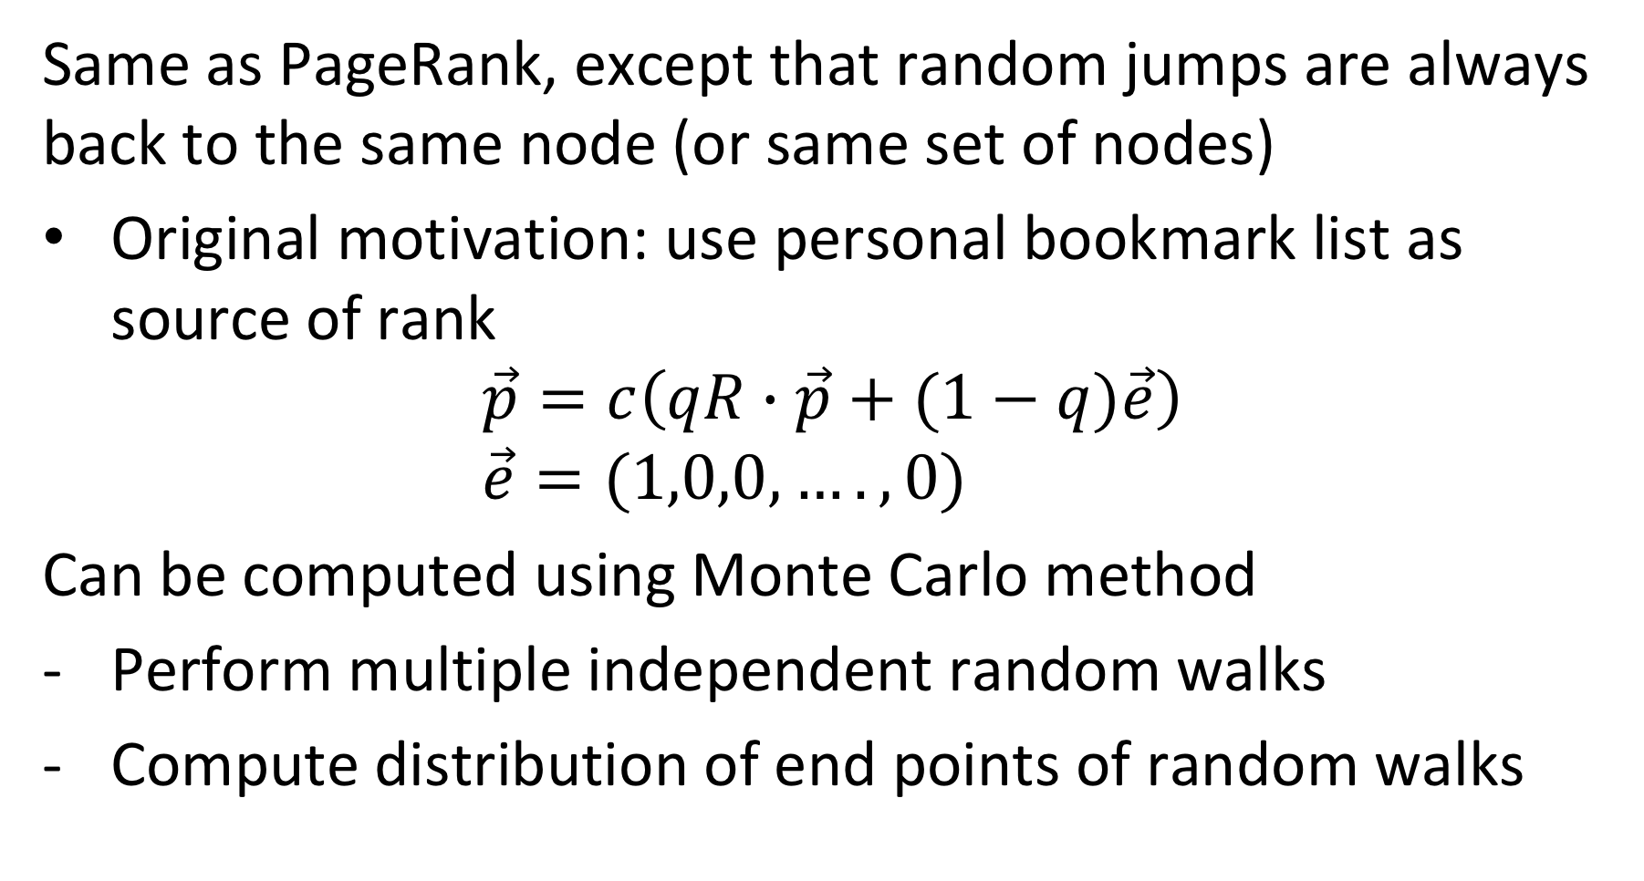
Personalized PageRank
Same as PageRank, except that random jumps are always back to the same node (or same set of nodes)
Original motivation: use personal bookmark list as source of rank
$$\vec{p}=c\left(qR∙\vec{p}+(1−q)\vec{e}\right) \\ \vec{e}=(1,0,0,….,0)$$
Can be computed using Monte Carlo method
Perform multiple independent random walks
Compute distribution of end points of random walks
Notes:
Personalized PageRank works almost the same as the original PageRank. The difference is that random jumps are not performed uniformly random to any other node of the graph, but to a selected subset of nodes. In the case of Web search this subset would be the personal bookmark list, and by jumping back to this subset nodes from that list will have a large influence on the ranking of a page, such that nodes that are well connected to the bookmarks will receive more ranking value.
PPR can be computed either like standard PageRank, or using a Monte Carlo method, by starting random walks independently and aggregate the distribution of the end points of those walks.

Slide 10
PPR on Entity Graph
Source node s
PPR_{s}(e) = high
PPR_{s}(.) = 0
e
PPR_{s}(.) = medium
s
PPR_{s}(.) = medium
PPR_{s}(s) = high
PPR_{s}(.) = 0
Notes:
Now applying PPR, by considering a source node s as the selected subset of preferred nodes, will generate a distribution of ranking values for all other nodes. Nodes that are well connected to s will naturally receive higher ranking values. Intuitively it is clear, that in our example node e will be receive higher ranking when starting from s, and this be probably the preferred interpretation for the entity.

Slide 11
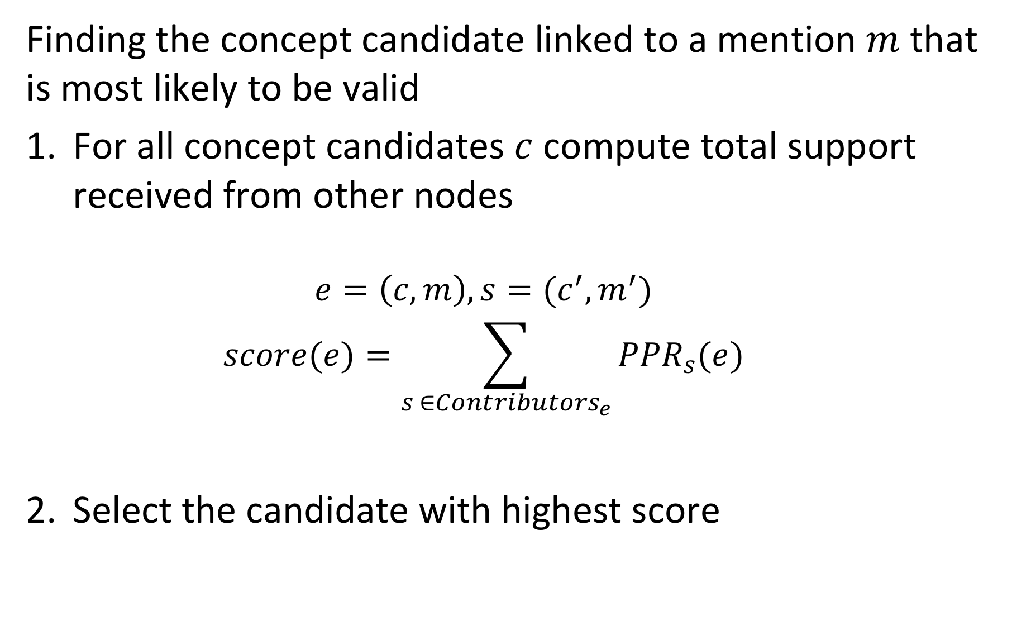
Approach
Finding the concept candidate linked to a mention $m$ that is most likely to be valid
For all concept candidates $c$compute total support received from other nodes
$$e=\left(c,m\right), s=(c^{′},m^{′})$$
$$score(e)=\sum_{s ∈{Contributors}_{e}}{{PPR}_{s}(e)}$$
Select the candidate with highest score
Notes:
The procedure for selecting the best concept candidate for a text mention is straightforward. One computes the total support that the candidate receives from other nodes s, by computing the PPR of e with the source node s a selected node. Which source nodes s are contributing to this computation we need still to determine. At the end the candidate with the highest score is selected.

Slide 12
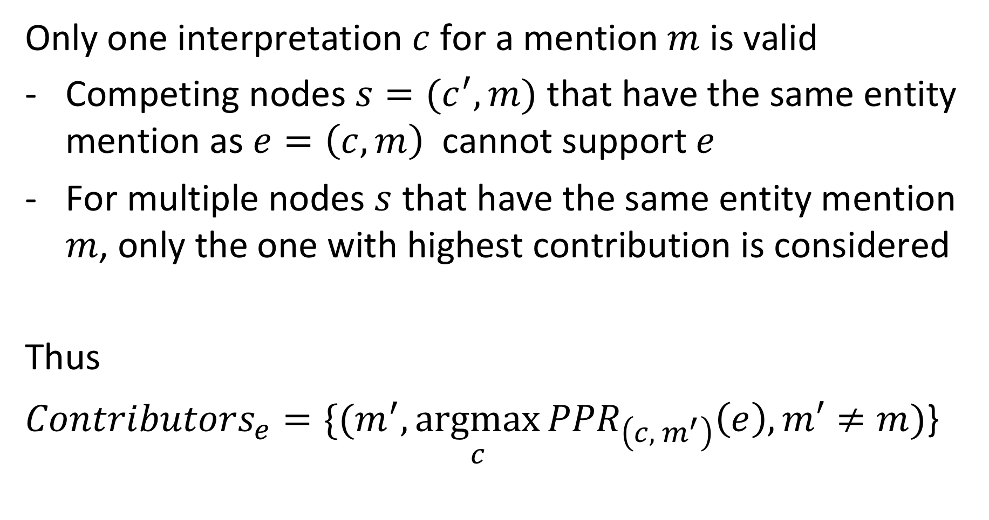
Contributing Nodes
Only one interpretation $c$ for a mention $m$ is valid
Competing nodes $s=(c^{′},m)$ that have the same entity mention as $e=\left(c,m\right)$ cannot support $e$
For multiple nodes $s$ that have the same entity mention $m$, only the one with highest contribution is considered
Thus
${Contributors}_{e}={\{(m}^{′},\underset{c}{argmax}{{PPR}_{\left(c, { m}^{′}\right)}\left(e\right),m′≠m)}$}
Notes:
Not every node should contribute as source node for a mention m, if we assume that only one interpretation can be correct. First, we exclude nodes that are “competing” for the interpretation of the text mention. Second for multiple nodes related to the some other entity mention, we select only the contribution of the one that has the highest value. In this way we favor a unique interpretation for mentions.

Slide 13
Example: Contributors_{e}
PPR_{s}(e) = high
PPR_{s}(.) = 0
Competing node
e
PPR_{s}(.) = medium
s
PPR_{s}(.) = medium
Lower contribution
PPR_{s}(s) = high
PPR_{s}(.) = 0

Slide 14
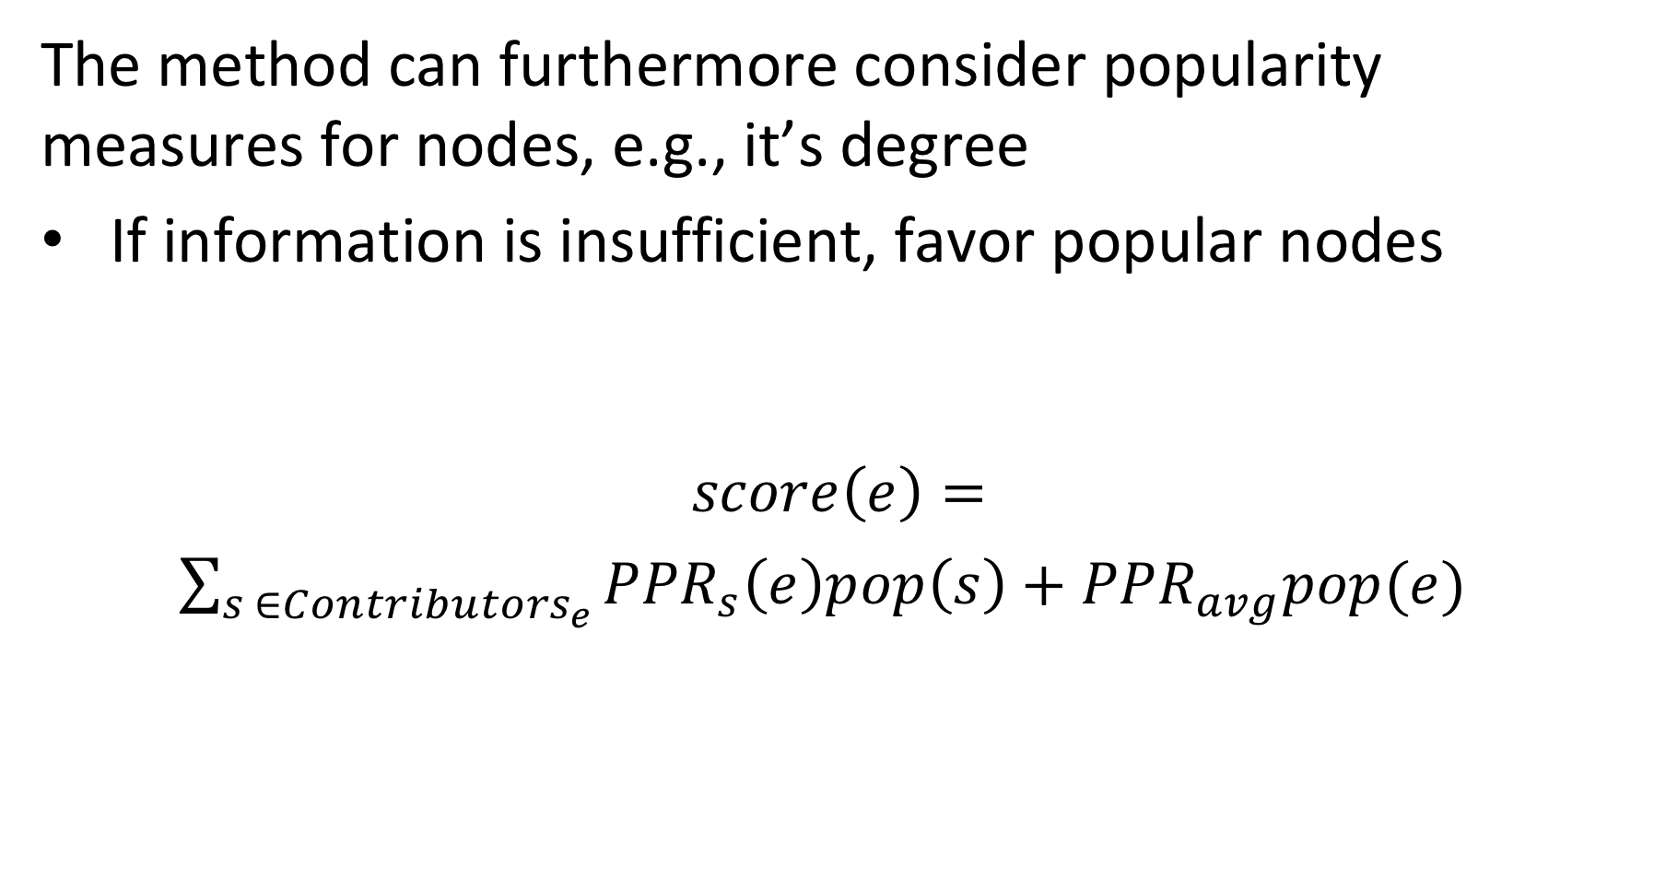
Considering Popularity
The method can furthermore consider popularity measures for nodes, e.g., it’s degree
If information is insufficient, favor popular nodes
$$score\left(e\right)=$$ $\sum_{s ∈{Contributors}_{e}}{{PPR}_{s}\left(e\right)pop\left(s\right)}+{PPR}_{avg}pop(e)$
Promotes contributions from popular nodes
Promotes popular nodes
Notes:
To further improve the method, one can add a general popularity measure to weight the contributions of source nodes.This will favor popular nodes, which is beneficial if little information is available for disambiguation. Then it is better to choose a popular candidate since chances that this is correct are higher. One of possible choice of a popularity score could be the number of links a node has in the knowledge base.

Slide 15
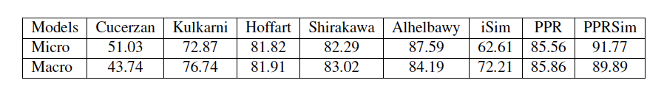
Some Results
Without popularity
Other methods
Uses pageRank
With popularity
Micro = fraction of correctly disambiguated entities
Macro = textual mentions, correctly disambiguated
per entity, averaged over all entities
Notes:
Experimental results show that the method works relatively will, with around 90% of entities that are correctly disambiguated. One can observe that the use of popularity helps to slightly improve the results.

Slide 16
Which is false?
Entity disambiguation addresses the problem of synonyms
Named entity recognition addresses the problem of synonyms
Entity disambiguation addresses the problem of entity classification
Named entity recognition addresses the problem of entity classification

Slide 17
Which nodes cannot contribute to the score of a mention linked to a concept?
Other concepts linked to the same mention
Concepts that have in the knowledge graph no outgoing links
Concepts that have in the knowledge graph no incoming links
Concepts with low popularity

Slide 18
2. Label Propagation

Slide 19
Inferring Attribute Values
Example problem: Which users on Twitter have positive or negative emotion towards a topic?
Users are nodes in a graph (follower network)
Emotion is an attribute of the node
Potential source of information in the case of Twitter
Emoticons in tweets: indicate stance of user towards the topic
Only a (small) fraction of the users is using emoticons
Notes:
A second inference task in knowledge bases, after entities have been disambiguated, is to assign to the entities correct attribute values. For discrete attributes this problem an be understood as a classification problem. This question has, for example, been studied for classifying users in a social network with respect to their stance or emotion towards a specific topic.
In the case of emotion analysis there exists typically indications of emotions, e.g., in the form of the use of emoticons or specific hashtags. However, only few users are using those.

Slide 20


Propagating Attribute Values
Assumption: nodes that are connected by an edge, have a higher propensity of sharing the attribute of interest
Twitter users following each other, are more likely to share the same emotion towards a topic
?
Probably:
Notes:
In many cases nodes that are connected by edges in a knowledge graph or as well in a social network, share properties. In social networks this is quite apparent. People that are connected through social links (e..g follower, friend, retweet, reply etc) are in general more likely to share opinions than those that are not. Is it possible to exploit this property to predict the attributes (respectively class lables) for those users that have none?

Slide 21
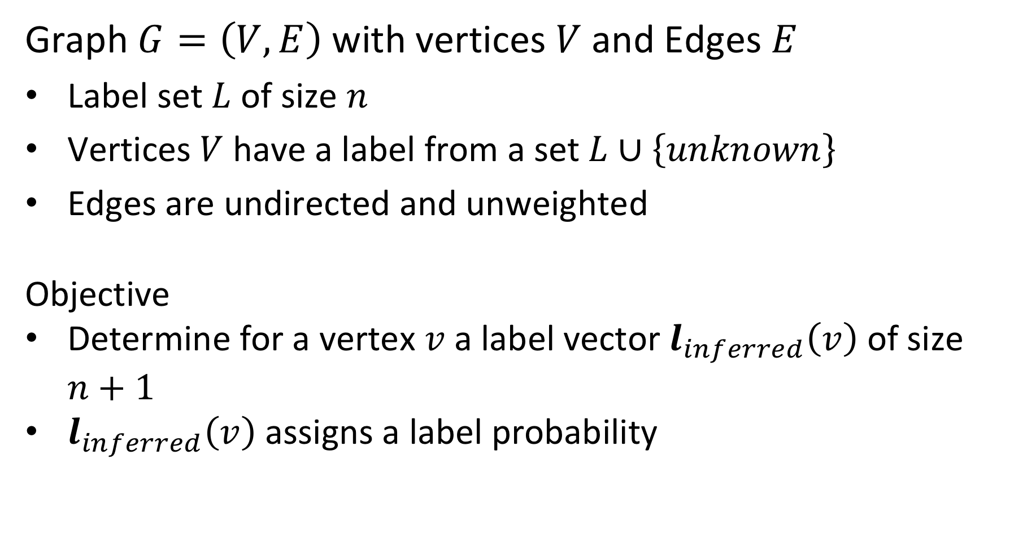
Model
Graph $G=\left(V,E\right)$ with vertices $V$ and Edges $E$
Label set $L$ of size $n$
Vertices $V$ have a label from a set $L∪\left\{unknown\right\}$
Edges are undirected and unweighted
Objective
Determine for a vertex $v$ a label vector $l_{inferred}\left(v\right)$ of size $n+1$
$l_{inferred}\left(v\right)$ assigns a label probability
Notes:
We consider the following model. A graph with vertices that can have either a label from a set L, or a lable unknown. The edges are all undirected and unweighted. The model and approach can be extended for directed graphs with weighted edges.
We associate with vertices probability distributions that represent our knowledge about the assignment of a label. For all vertices we will compute an inferred probability distribution.

Slide 22
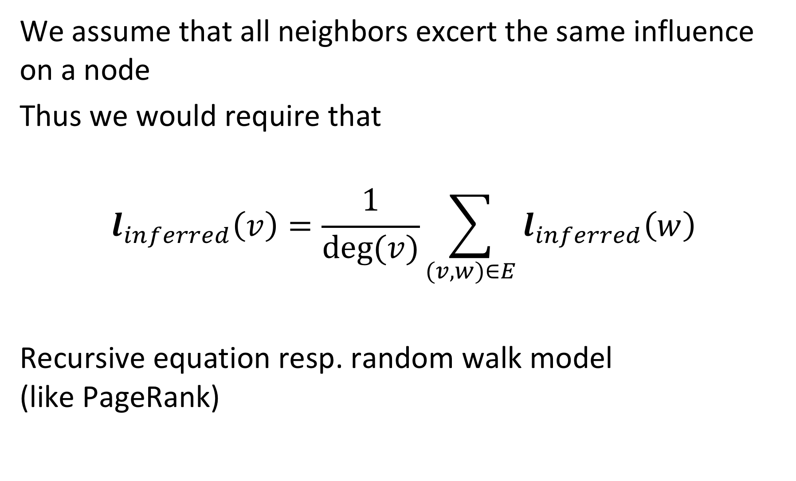
Label Inference
We assume that all neighbors excert the same influence on a node
Thus we would require that
$$l_{inferred}\left(v\right)=\frac{1}{deg⁡(v)}\sum_{(v,w)∈E}{l_{inferred}\left(w\right)}$$
Recursive equation resp. random walk model (like PageRank)
Notes:
In this model we assume that all neighbors of a node in the graph are equally influencing it. Thus, we can compute its expected label distribution by averaging the distributions of the neighbors. The resulting equation is analogous to the formulation of the PageRank model. Thus the Label Inference can be interpreted as a random walk model.
The model can be extended to weighted graphs, in which case the edge weight would be considered in the aggregation of the distributions of the neighboring vertices.

Slide 23
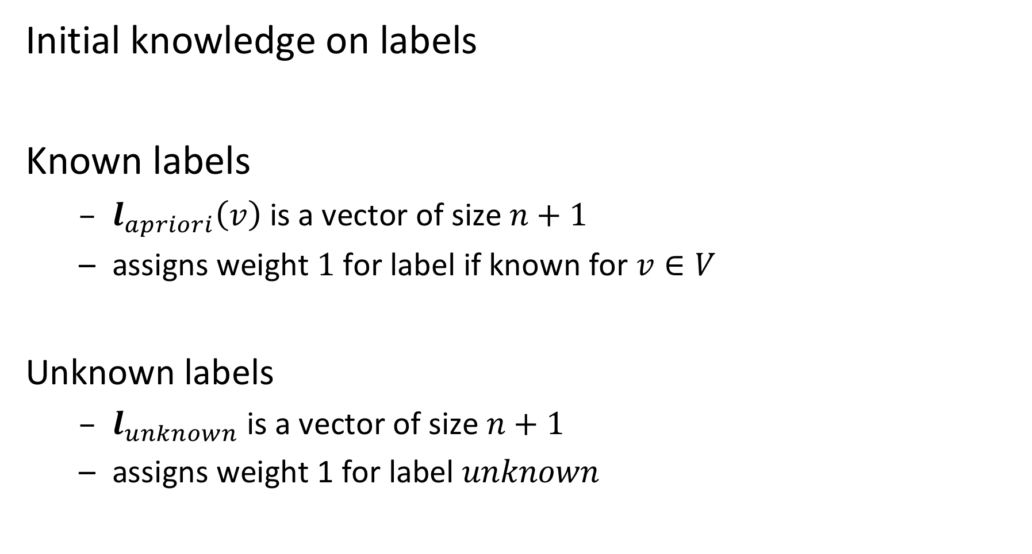
Adding Pre-existing Knowledge
Initial knowledge on labels
Known labels
$l_{apriori}\left(v\right)$ is a vector of size $n+1$
assigns weight $1$ for label if known for $v∈V$
Unknown labels
$l_{unknown}$ is a vector of size $n+1$
assigns weight 1 for label $unknown$
Notes:
For some vertices we have an apriori assignment of labels (these are the vertices for which the label is known). For vertices that have no apriori label assigned we have a vector to represent the unknown state. Note that the apriori distribution can also be a true probability distribution, if we are initially not sure about the label, but have some partial knowledge.

Slide 24
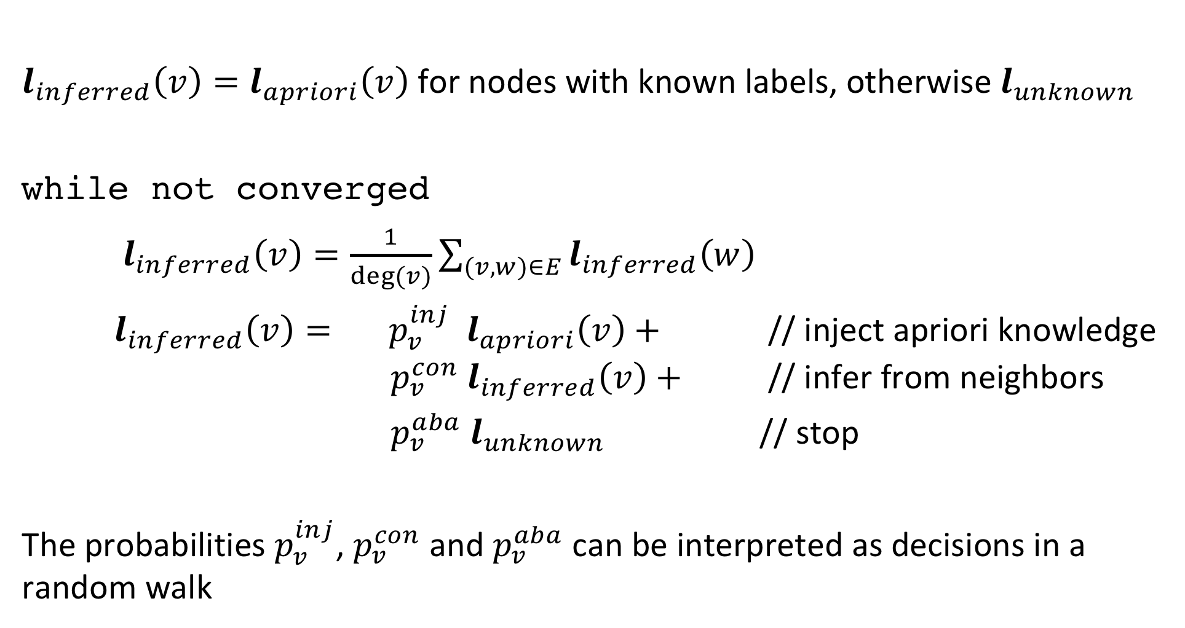
Label Propagation Algorithm
$l_{inferred}\left(v\right)=l_{apriori}\left(v\right)$ for nodes with known labels, otherwise $l_{unknown}$
while not converged
$l_{inferred}\left(v\right)=\frac{1}{deg⁡(v)}\sum_{(v,w)∈E}{l_{inferred}\left(w\right)}$
$l_{inferred}\left(v\right)= p_{v}^{inj}{ l}_{apriori}\left(v\right)+$ // inject apriori knowledge $p_{v}^{con}{ l}_{inferred}\left(v\right)+$ // infer from neighbors
$p_{v}^{aba}{ l}_{unknown}$ // stop
The probabilities $p_{v}^{inj}$, $p_{v}^{con}$ and $p_{v}^{aba}$ can be interpreted as decisions in a random walk
Notes:
The full label propagation model adds additional aspects to the propagation of labels to neighbors.
For vertices with apriori labels, at every step the apriori distribution is injected with a certain probability $p_{v}^{inj}$ that depends on the vertice
For all vertices the propogation process can also be abandoned with a certain probability $p_{v}^{aba}$
The propagation of the label distribution to neighbors occurs then with a (remaining) probability of $p_{v}^{con}$
As in PageRank the process is iterated till convergence occurs.

Slide 25
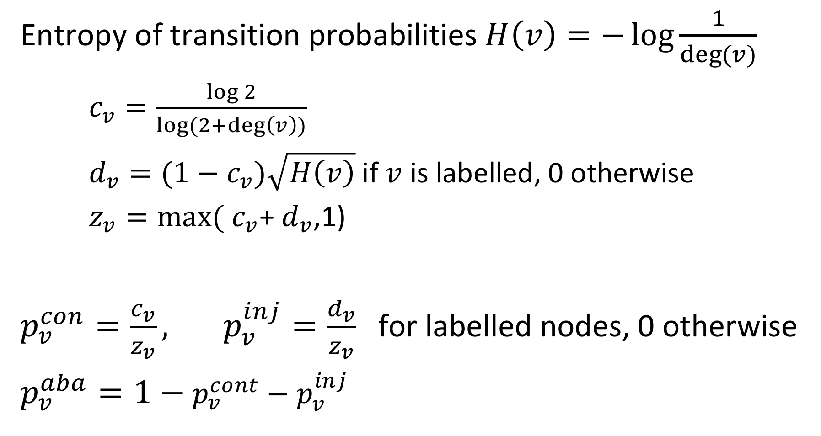
Determining the Probabilities
Entropy of transition probabilities $H\left(v\right)=−\log{\frac{1}{deg⁡(v)}}$
$c_{v}=\frac{\log{2}}{\log{(2+\deg\left(v\right))}}$
$d_{v}=(1−c_{v})\sqrt{H\left(v\right)}$ if $v$ is labelled, 0 otherwise
$z_{v}=\max{(}$ $c_{v}$+ $d_{v}$,1)
$p_{v}^{con}=\frac{c_{v}}{z_{v}}, p_{v}^{inj}=\frac{d_{v}}{z_{v}}$for labelled nodes, 0 otherwise
$p_{v}^{aba}=1−$ $p_{v}^{cont}−p_{v}^{inj}$
Notes:
The transition probabilities depend on the properties of the vertices. In our model, the only relevant property is its degree.
In a more general model with edge weights the probabilities would depend on the distribution of edge weights of the edges connected to the vertice (Fan-out entropy heuristics)

Slide 26
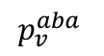
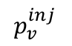
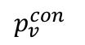
Behavior of Probabilities: Labelled Nodes
Injection probability increases with the degree of the nodes, while continuation probability decreases
Abandoning probability positive for only very low degree nodes (d = 1,2)
$$p_{v}^{con}$$
$$p_{v}^{inj}$$
$$p_{v}^{aba}$$
Notes:
For labelled nodes the injection probability increases with the degree. Thus, well connected pre-labelled nodes have a lot of influence.

Slide 27
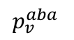
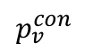
Behavior of Probabilities: Unlabelled Nodes
Abandon probability increases with degree
Prevents algorithm from propagating information through unlabeled, high-degree nodes
$$p_{v}^{con}$$
$$p_{v}^{aba}$$
Notes:
For unlabeled nodes the behavior the abandon probability increases with the degree. Thus, high degree nodes have less influence.

Slide 28
Extensions
Label Propagation can be extended to
A priori knowledge given as probability distribution
Graphs with weighted edges
Directed Graphs
Alternative algorithm: MAD (modified adsorption)
Formulates an optimization problem and solves it directly
Slightly better performance in practice

Slide 29
Discussion
Label propagation is an example of a semi-supervised learning algorithm
Exploit partial labelling
Useful in cases where labels are sparse or labels can produced only for special cases using heuristics or background knowledge
Require that relationships among entities and their labels are correlated by some underlying principle

Slide 30
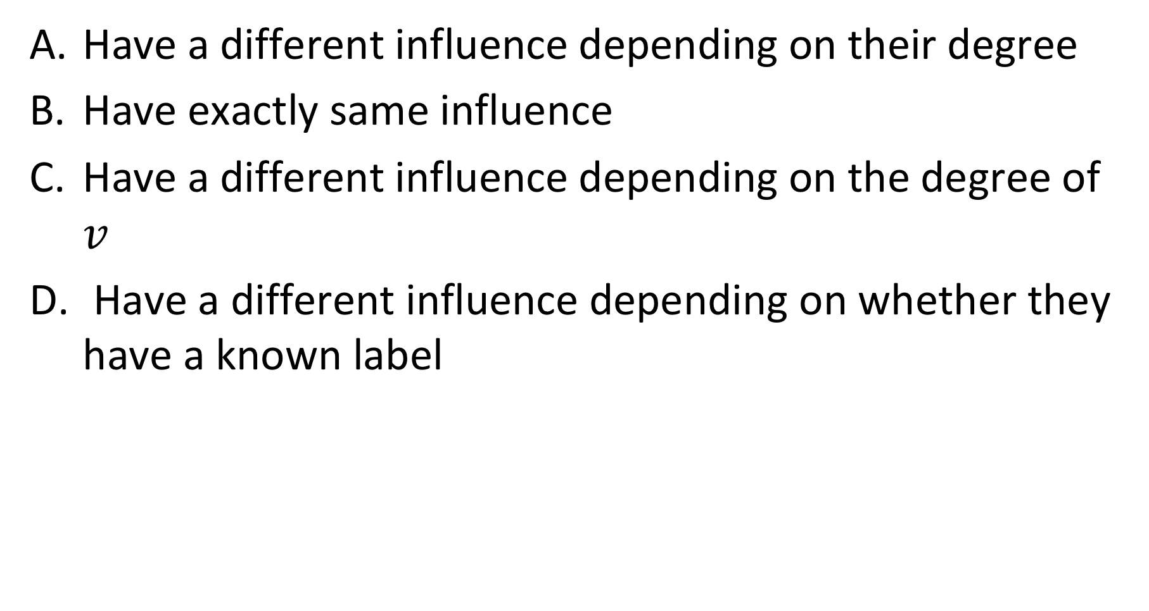
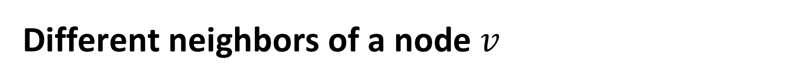
Different neighbors of a node $v$
Have a different influence depending on their degree
Have exactly same influence
Have a different influence depending on the degree of $v$
Have a different influence depending on whether they have a known label

Slide 31

The probabilities $p_{v}^{inj}$, $p_{v}^{con}$ and $p_{v}^{aba}$ depend on
The node degree
The pre-existing knowledge on labels
On both node degree and pre-existing knowledge
On further factors

Slide 32
3. Link Prediction

Slide 33
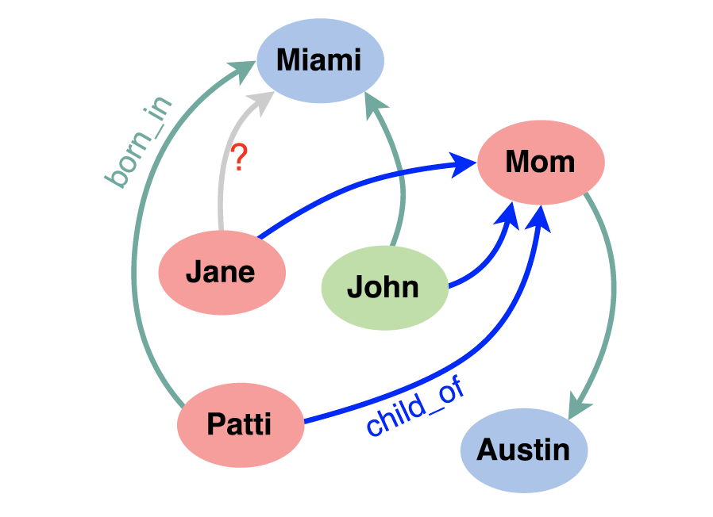
Knowledge Base Completion
Large knowledge bases are usually incomplete
DBPedia: 60% of persons miss place of birth
FreeBase: 71% of persons miss place of birth etc.
Try to predict missing links from existing data
Jane born in Miami?
Notes:
In general, knowledge bases are incomplete. Thus there is a significant interest in completing in particular the relationships among entities. To do so one might exploit “patterns” that entities and relationships follow, and generalize them.

Slide 34
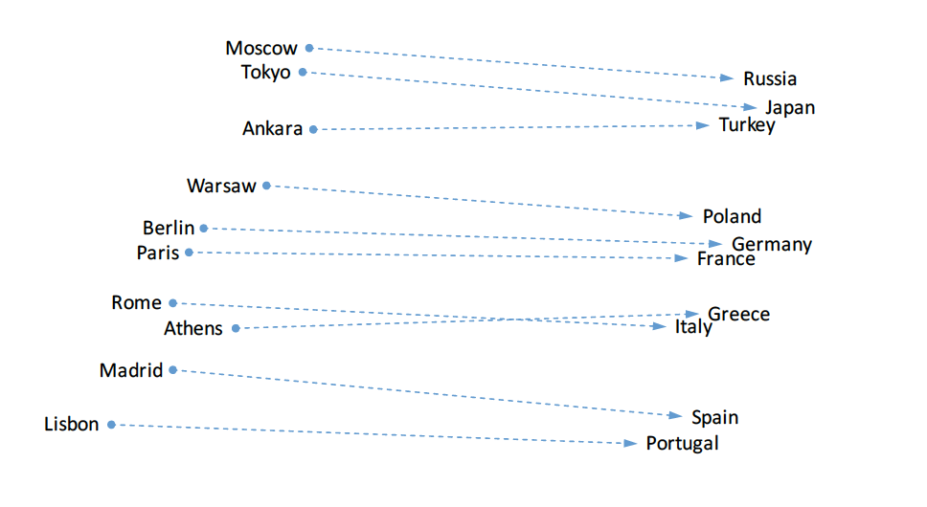
Observation on Word Embeddings
Notes:
In order to tackle this problem, we come back to an observation that we had made for word embeddings. We found that (in some cases) relationships seem to be encoded as linear transformations.

Slide 35
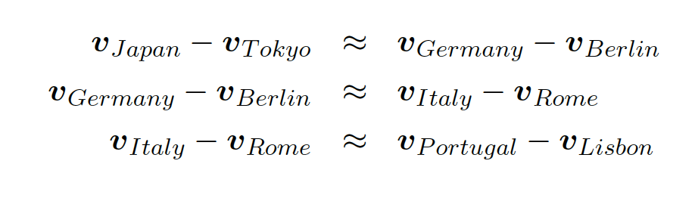
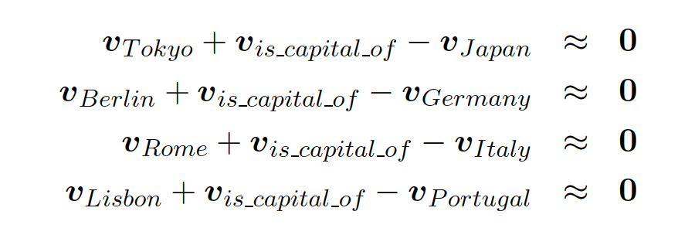
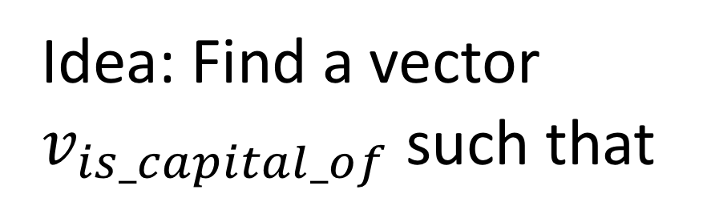
Relations in Word Embeddings
Idea: Find a vector
$v_{is_capital_of}$ such that
Relations are also represented as embedding vectors!
Notes:
This observation can be formally described in two different ways. We could say, that the differences of entity vectors that are in a relationship should result in similar values. Alternatively, we sould also say, that there must be some vector that represents the relationship and that the sum of this vector with the difference vector of the entities should be approximately zero. This second formulation of the properties gives rise to an idea of how link prediction could be performed using and embedding technique.

Slide 36
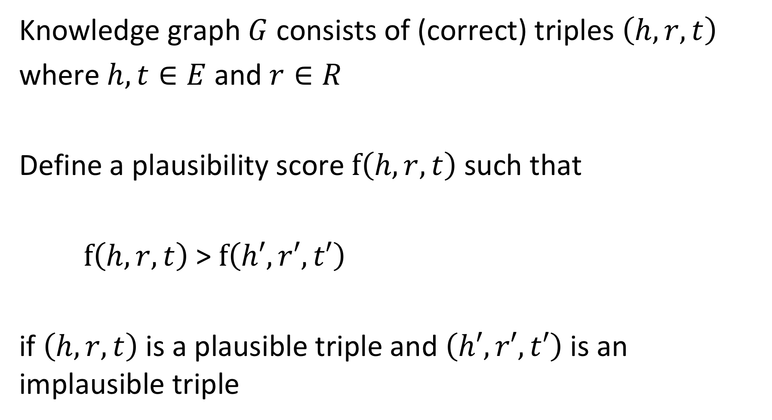
Model
Knowledge graph $G$ consists of (correct) triples $\left(h,r,t\right)$
where $h,t∈E$ and $r∈R$
Define a plausibility score $f\left(h,r,t\right)$ such that
$f\left(h,r,t\right)$ > $f\left(h′,r′,t′\right)$
if $\left(h,r,t\right)$ is a plausible triple and $\left(h′,r′,t′\right)$ is an implausible triple
Notes:
To formulate the model we assume that we have a knowledge graph consisting of triples $\left(h,r,t\right)$. $h$ indicates the term “head” and $t$ the term “tail”.
Then we introduce a function that measure how plausible a triple is (we can think of it as a probability). Clearly, the function should return higher values for plausible tuples than for implausible ones.

Slide 37
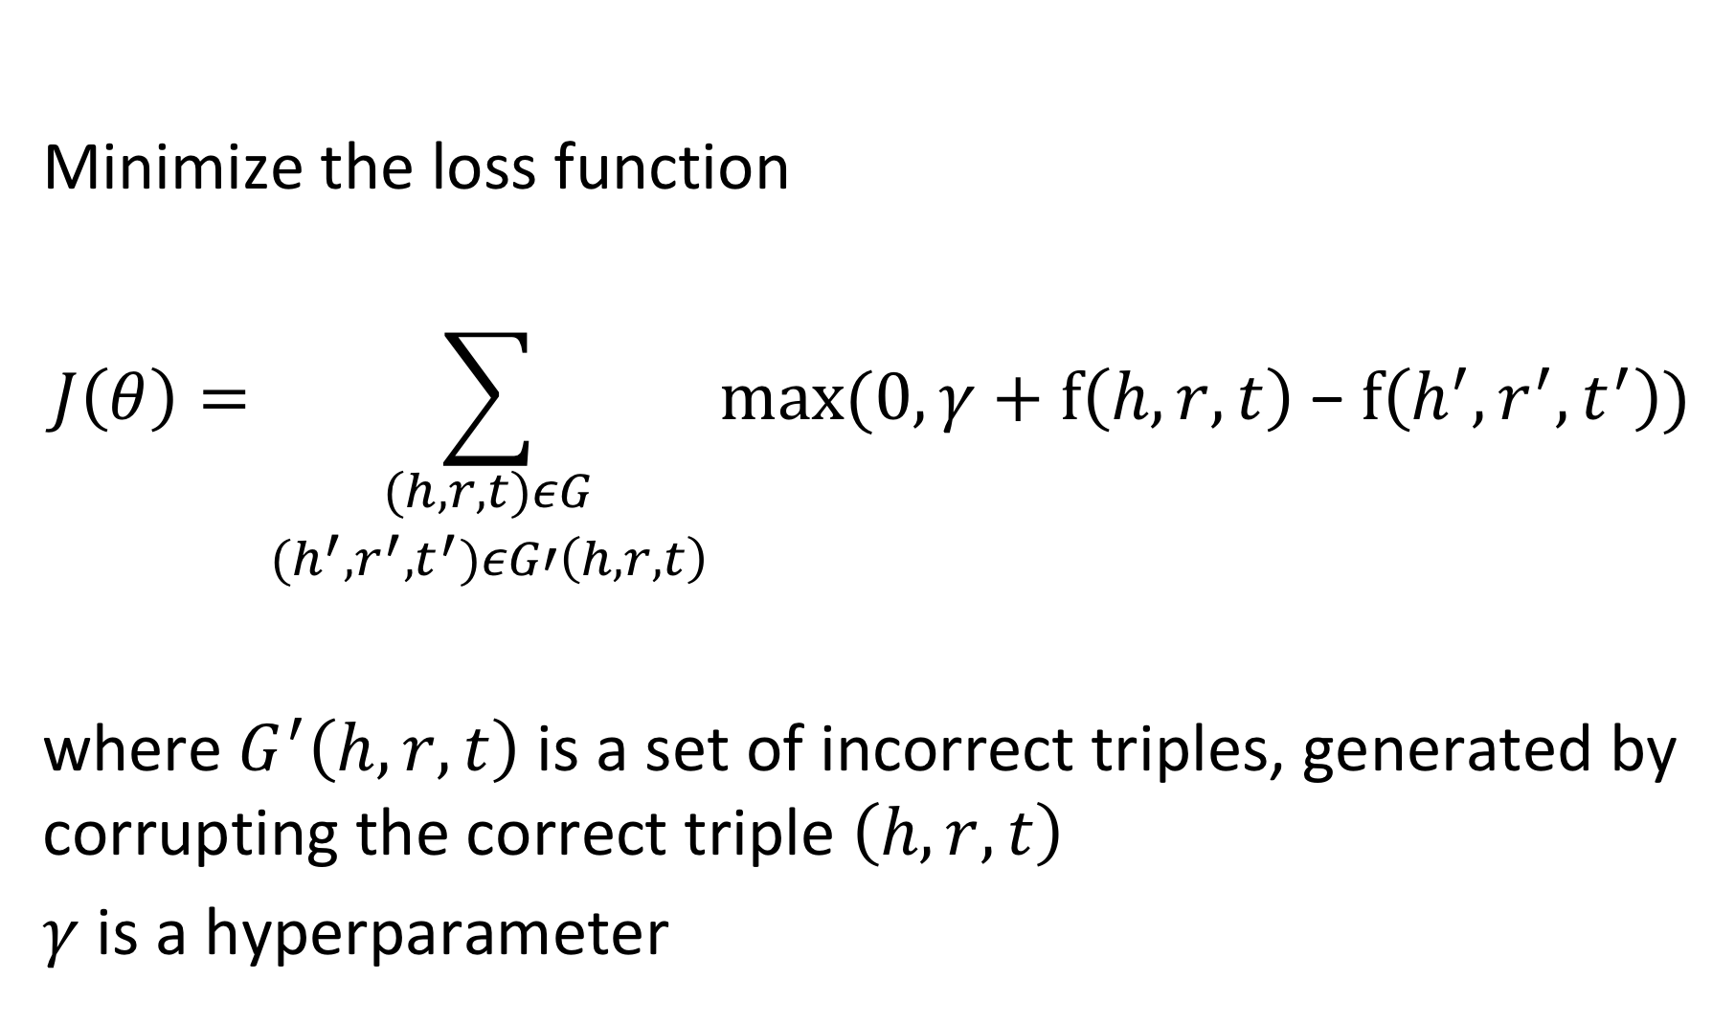
Learning the Model
Minimize the loss function
$$J\left(θ\right)=\sum_{\begin{aligned}(h,r,t)εG \\ (h^{′},r^{′},t^{′})εG′\left(h,r,t\right)\end{aligned}}{max⁡(0,γ+f\left(h,r,t\right) \text{−} f\left(h^{′},r^{′},t^{′}\right))}$$
where $G^{′}\left(h,r,t\right)$ is a set of incorrect triples, generated by corrupting the correct triple $\left(h,r,t\right)$
$γ$ is a hyperparameter
Notes:
Using the plausibility function, we can formulate a loss function that should be minimized. The minimization will be performed as usual using SGD.

Slide 38
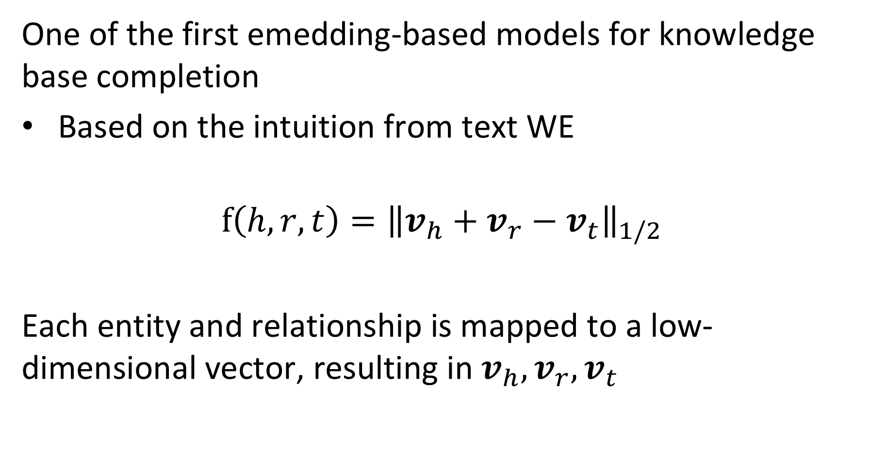
TransE Model
One of the first emedding-based models for knowledge base completion
Based on the intuition from text WE
$$f\left(h,r,t\right)={\left\|v_{h}+v_{r}−v_{t}\right\|}_{1/2}$$
Each entity and relationship is mapped to a low-dimensional vector, resulting in $v_{h}, v_{r},v_{t}$
Notes:
With the generic model we can instantiate difference concrete approaches for link prediction, depending on the choice of f. One of the initial approaches that was strongly inspired by our initial observation on word embeddings from the beginning. It directly introduces a vector $v_{r}$ that represents the linear transformation corresponding to a relationship, and mapping the head and tail into the same (low-dimensional) vector space.
The mappings from the entities and relationships to the latent space are performed (as in word embeddings) using embedding matrices, which constitute the model parameters that have to be learnt using SGD.

Slide 39
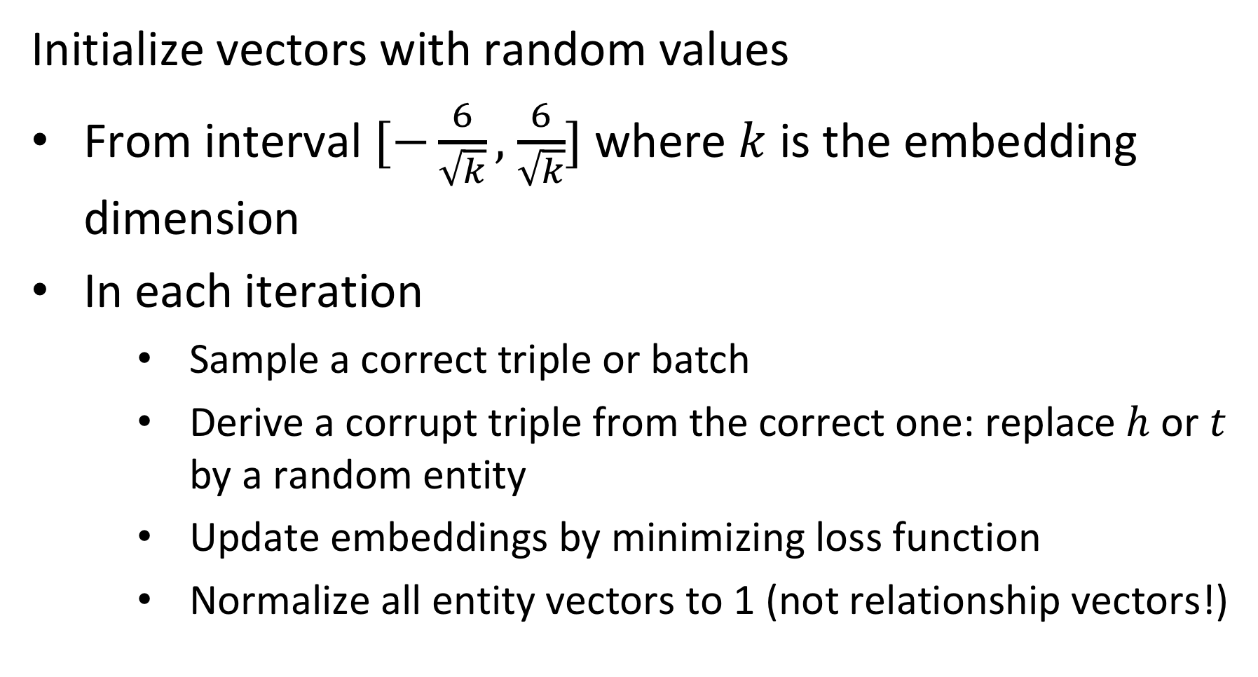
Performing SGD
Initialize vectors with random values
From interval $[−\frac{6}{\sqrt{k}},$ $\frac{6}{\sqrt{k}}]$ where $k$ is the embedding dimension
In each iteration
Sample a correct triple or batch
Derive a corrupt triple from the correct one: replace $h$ or $t$ by a random entity
Update embeddings by minimizing loss function
Normalize all entity vectors to 1 (not relationship vectors!)
Notes:
The SGD algorithm proceeds as follows. First the vectors are initialized with random values (the choice is motivated by empirical findings from neural network training). Then in every iteration a triple (or several triples are randomly chosen). Negative samples are generated by randomly replacing head or tail (not both). The update of the embeddings is performed as usual by computing the differential of the loss function. Entity vectors are normalized to 1 in every iteration (this avoids the model to find a trivial solution).

Slide 40
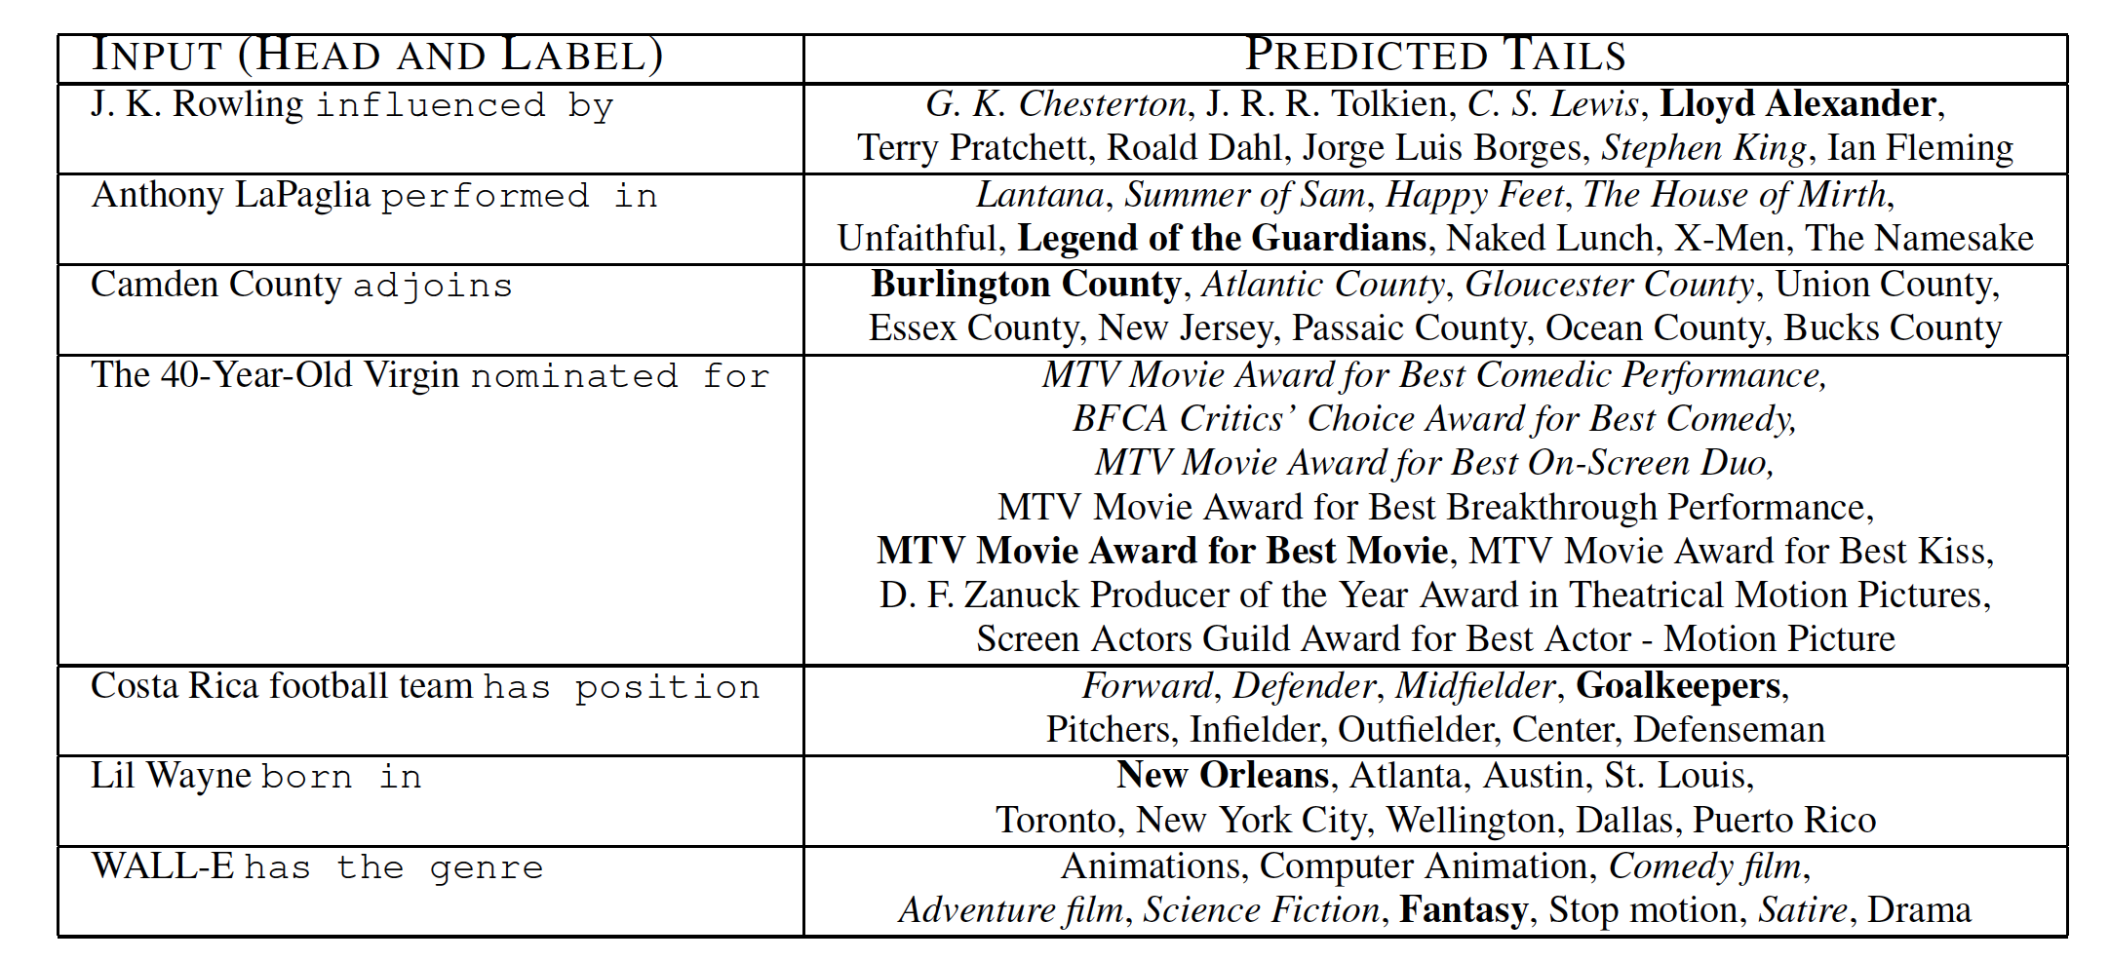
Qualitative Results
Notes:
The qualitative results show that the method works reasonably well. The bold phrases are the correct predections. However, given that the knowledge bases used for evaluation are incomplete, it is not out of question that also other predictions are meaningful.

Slide 41
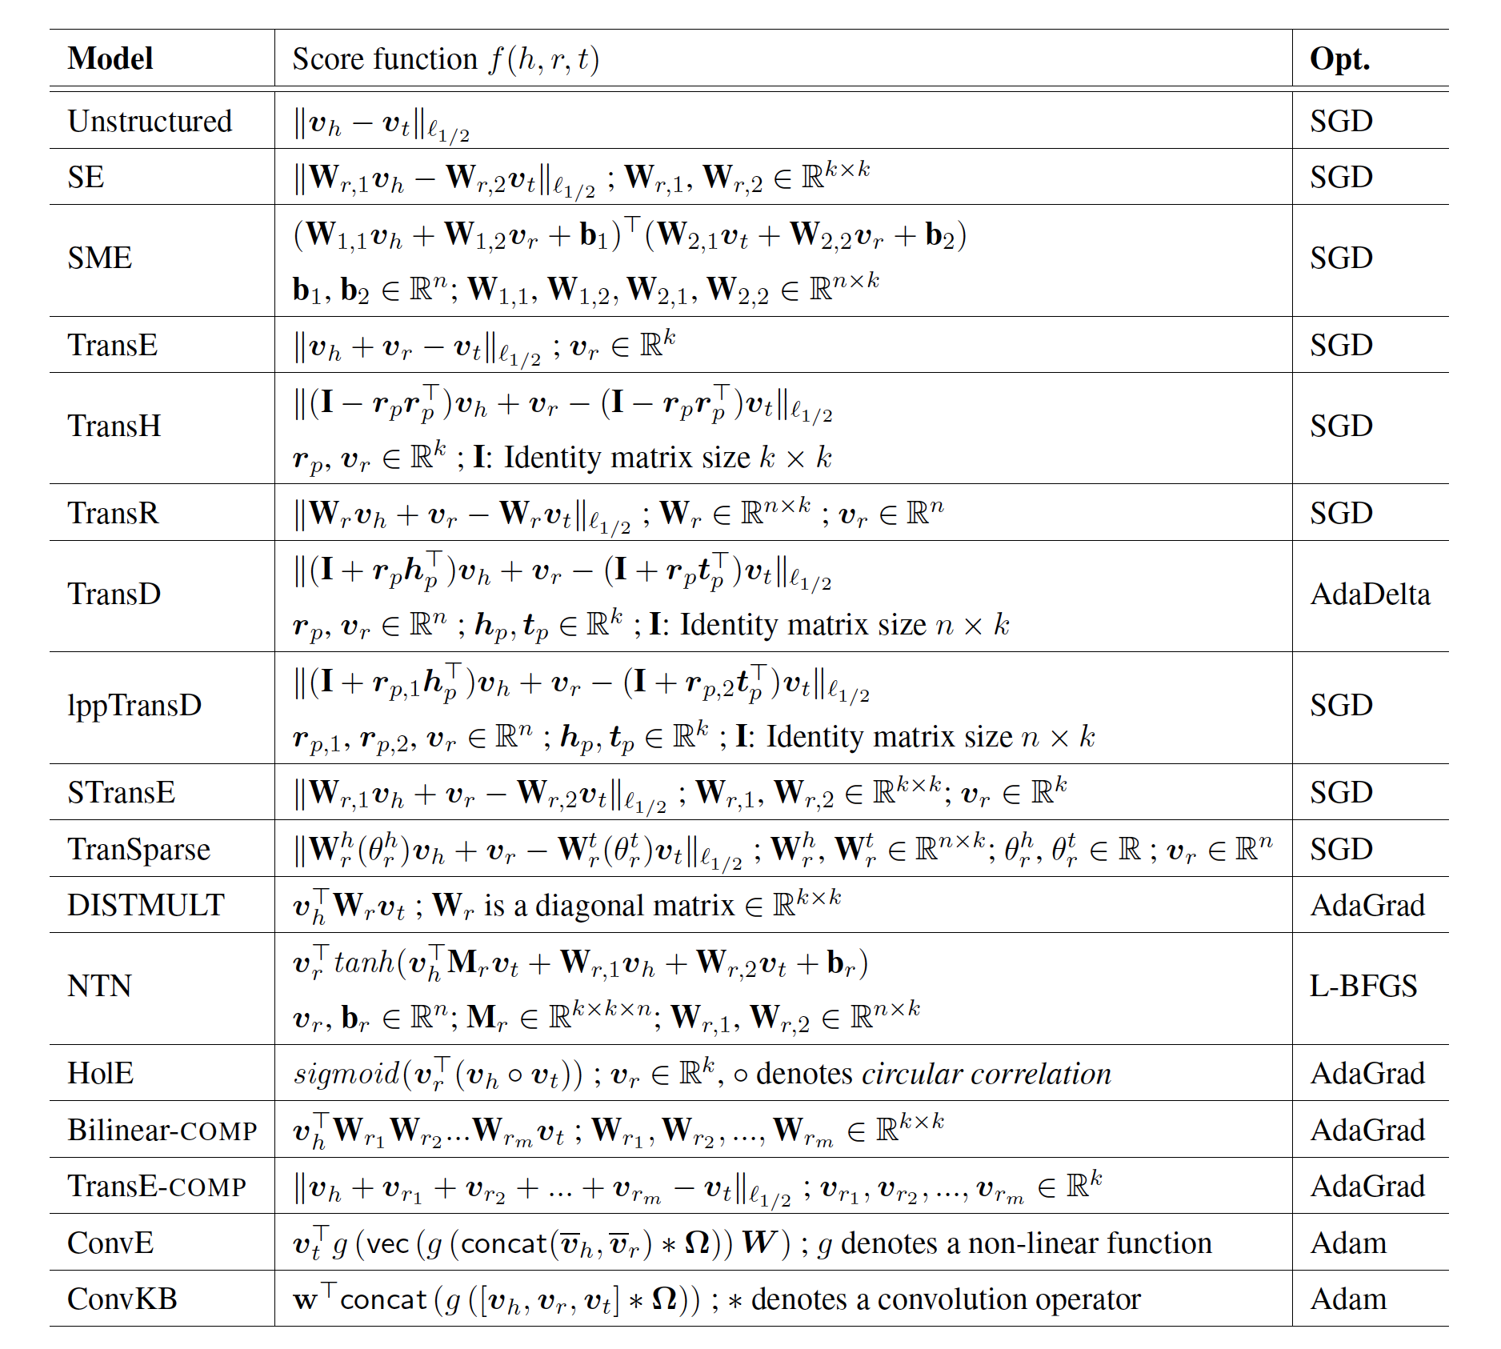
Alternative Models
Notes:
The TransE method is only one example of very many methods that have been in the meanwhile proposed to tackle the link prediction problem.

Slide 42
Which is true? The score function f(h,r,t) …
has always larger values for triples (h,r,t) that are part of the known knowledge graph than for other triples
maps triples to vectors in the embedding space
is always positive
is optimized by stochastic gradient descent

Slide 43
4. Data integration

Slide 44
Key Tasks in Distributed Information Management
More data! … More models!? … More useful information?
Information System M2
Information System M1
Interpretation I2
DB2
information
supply
DB1
Interpretation I1
corresponding R’ ?
(another interpretation!)
some relationship R
Information System MyM
information
demand
R' is a mapping
among models!
MyDB
My Interpretation I
Notes:
This figure illustrates the problem of information starvation: there exist many information systems supplying data, but each having their own view on the world, which does not necessarily match the needs or understanding of a specific consumer. Every information system is interpreting its model differently with respect to the real world and relating to different views on the real world. Though there exists some relationships among all these views on the real world (let’s denote it as R), and it surely implies some relationship R’ among the different models used in the different information systems, the consumers of the information cannot easily understand the relationship R, and thus can also not easily relate their models to the models of others via the relationship R’. From the viewpoint of the data providers, introducing R’ introduces a new interpretation of their data with respect to the model used by the data consumer.

Slide 45
Schema Matching
Integration of heterogeneous data sources
Every project on Big Data analysis first has to integrate data from different, heterogeneous data sources
Different schemas, taxonomies, knowledge graphs
One of the long-standing open problems in data management
How to find good “matches”?
How to choose the “best matches”?
Name
c1
Person_name Company_name
?
c2
Notes:
Schema matching is a long standindg problem, both in industry and research.

Slide 46
Schema Matching Approaches
Manual matching
still common practice today
Schema matching tools
Based on structural and content features
names, domains, structure, values, …
Establish correspondences and rank according to quality
Errors are frequent and unavoidable
Works well for small schemas

Slide 47
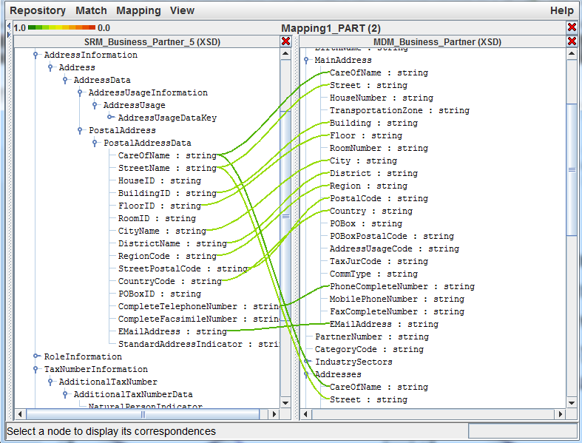
Schema Matching Tools

Slide 48
The Problem
Given two (hierarchical) knowledge graphs D1, D2
Goal: find a 1:1 matching of nodes (entities, classes) that have the same or similar “meaning”
Assumption: two nodes (classes) are considered similar, if they have the same or similar instances (entities)
Notes:
In the following we will study the problem of integrating heterogeneous databases respectively knowledge graphs. We assume that we want to integrate data that are available in two knowledge graphs that are semantically related to each other.
We will make a few assumptions:
the knowledge graph is hierarchical. It could also be a taxonomy.
Some entities represent classes. We are in particular interested in matching those.
Entities that represent classes share similar kinds of instances, which are entities.

Slide 49
Example
D2
D1
Notes:
Let us assume that we have two example knowledge graphs. By inspecting the databases, a human can easily recognize that class A in graph D1 corresponds to class B in graph D2. The problem is how to perform the task of identifying this correspondence automatically.

Slide 50
Universe of a Database
Universe U is a finite set of possible instances
Example: U = {u, computer science, mathematics, life sciences, A, c1, c2, c3, information systems, aberer, signal processing, vetterli, databases, ailamaki, …}
Notes:
One basic approach to assess whether two classes are similar, is to measure their level of similarity at the content level, i.e., to test to which extent the elements (=instances) of the two classes overlap.

Slide 51
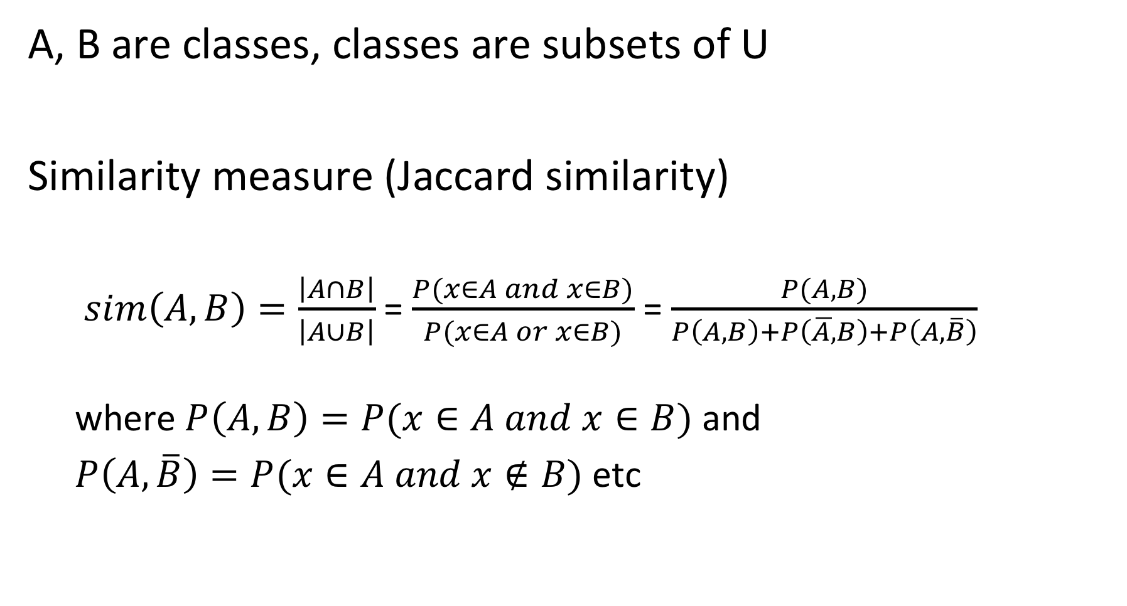
Similarity of Classes
A, B are classes, classes are subsets of U
Similarity measure (Jaccard similarity)
$sim\left(A,B\right)=\frac{\left|A∩B\right|}{\left|A∪B\right|}$ = $\frac{P(x∈A and x∈B)}{P(x∈A or x∈B)}$ = $\frac{P(A,B)}{P\left(A,B\right)+P\left(\overline{A,}B\right)+P\left(A,\overline{B}\right)}$ where $P\left(A,B\right)=P(x∈A and x∈B)$ and
$P\left(A,\overline{B}\right)=P(x∈A and x∉B)$ etc
Notes:
The Jaccard measure is a standard approach to measure such a set similarity.

Slide 52
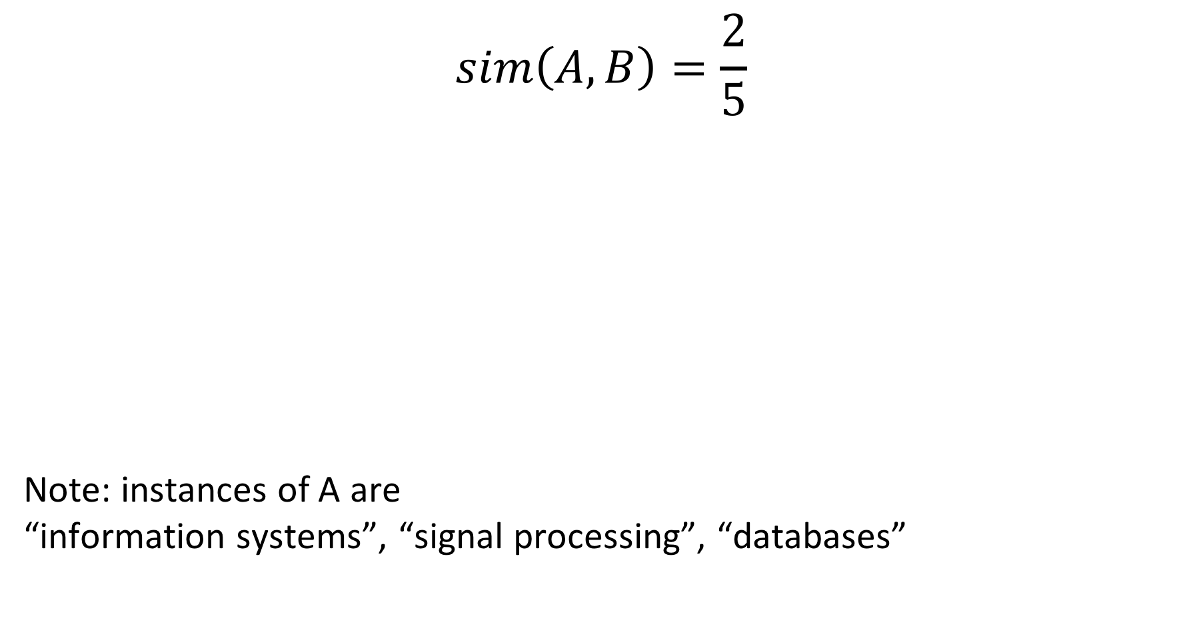
Example
$$sim\left(A,B\right)=\frac{2}{5}$$
Note: instances of A are “information systems”, “signal processing”, “databases”
Notes:
In this example the two classes have 2 common elements, and the number of all elements in their union is 5, thus the Jaccard similarity is 2/5.

Slide 53
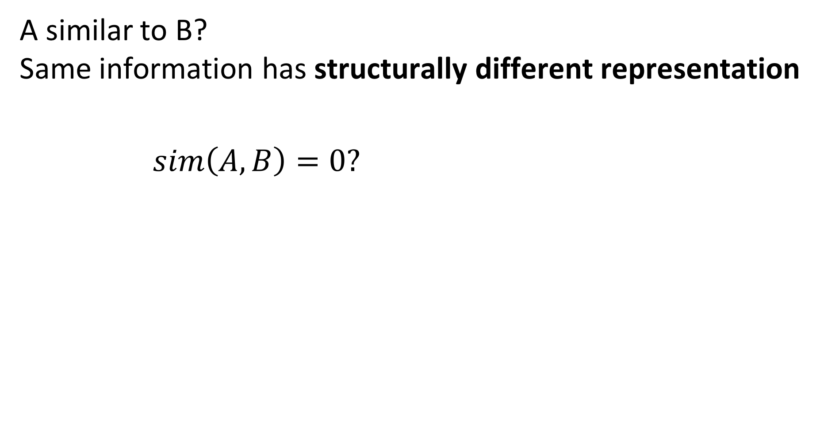
Problem 1
A similar to B? Same information has structurally different representation
$sim\left(A,B\right)=0?$
Note: instances of A are c1, c2, c3
Notes:
In the previous example, the instances of the two classes have been leaf nodes in the knowledge graph. Therefore it was straightforward to compare their instances directly. In a general knowledge graph, the correspondences are not always that simple. In this example, we see that classes A and B correspond to each other, even if A has as instances complex data (nodes ci) and B atomic data (Strings). More complex features of classes are required. For the example shown, this is easy to resolve, by considering the atomic data found at leaf level for an inner node, such as A.

Slide 54
Problem 2
Two databases might have
Classes with similar meaning (e.g. Course)
Different Instances for those classes (e.g. different courses at different universities)
Intension is similar, but extension is different
Notes:
Due to different database extensions and different naming conventions even classes that have a strong semantic similarity often have no common instances in two different databases.

Slide 55
Complex Features of Classes
Considering the instances (direct children) of classes is only an example of a simple class feature
Many complex features can be exploited (and have been exploited in schema matching)
Names of attributes and relationships
Structural relationships (data types)
Distributional features (data values)
Content features (e.g., text)
Notes:
In database integration, many different features that can be associated with structural elements of a database have been considered for establishing semantic correspondences. For illustration, we will use in the following a simple feature: the set of atomic data values (strings) that can be reached from a node in the knowledge graph.

Slide 56
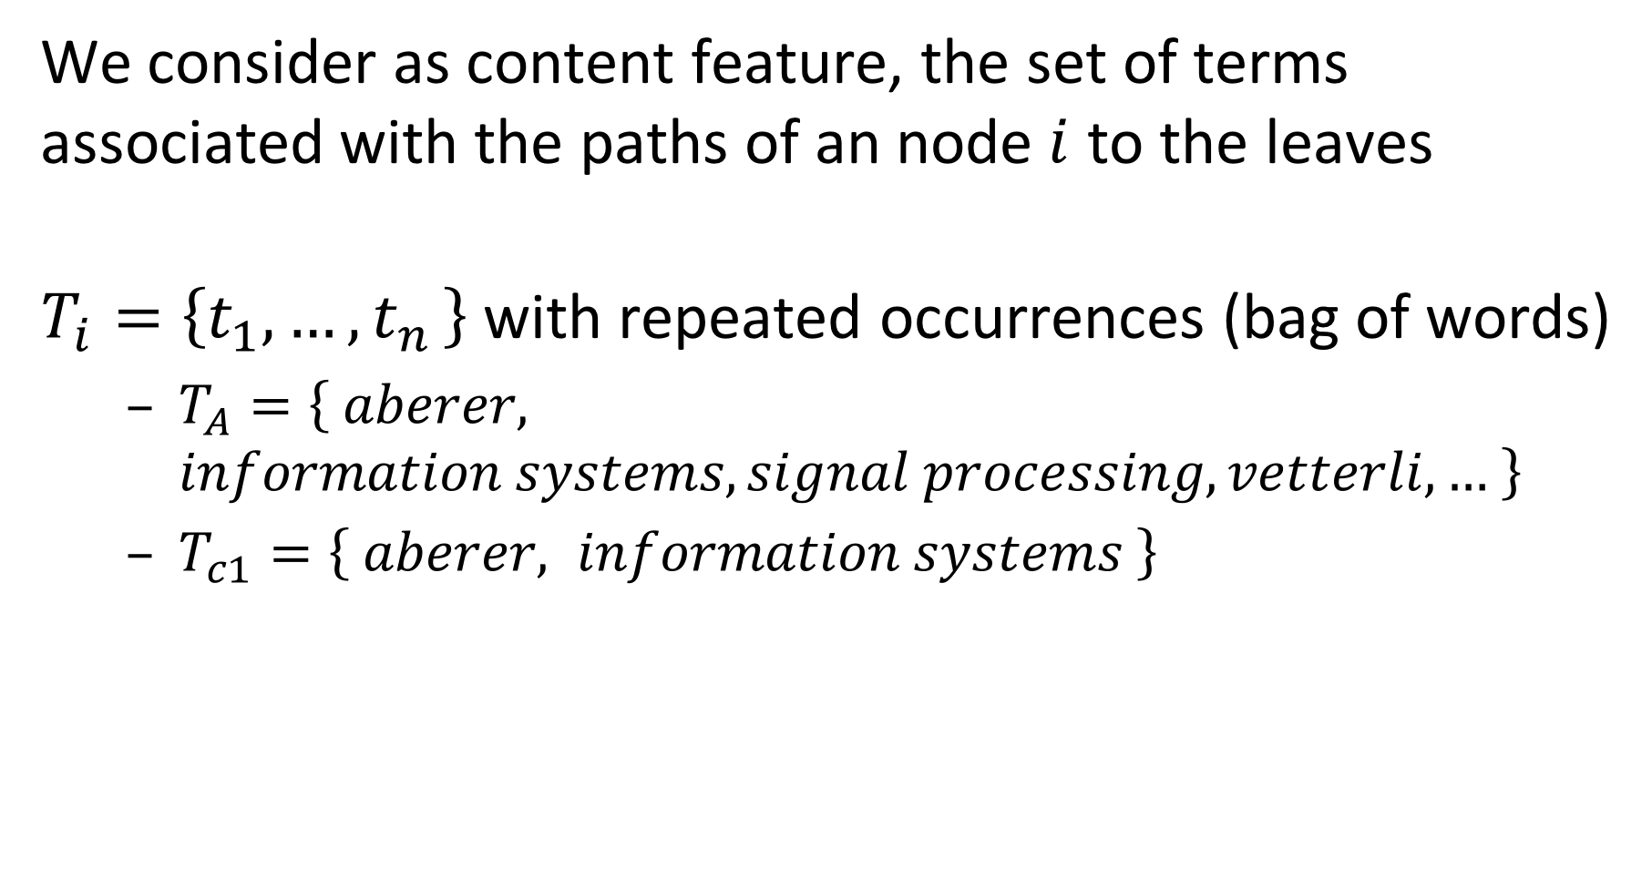
Content Feature of Classes
We consider as content feature, the set of terms associated with the paths of an node$i$ to the leaves
$T_{i}=\left\{t_{1},{…,t}_{n}\right\}$ with repeated occurrences (bag of words)
$T_{A}=\left\{ aberer, information systems, signal processing, vetterli,… \right\}$
$T_{c1}=\left\{ aberer, information systems \right\}$
Notes:
Another feature that can be exploited for this case would be the labels used along the paths.

Slide 57
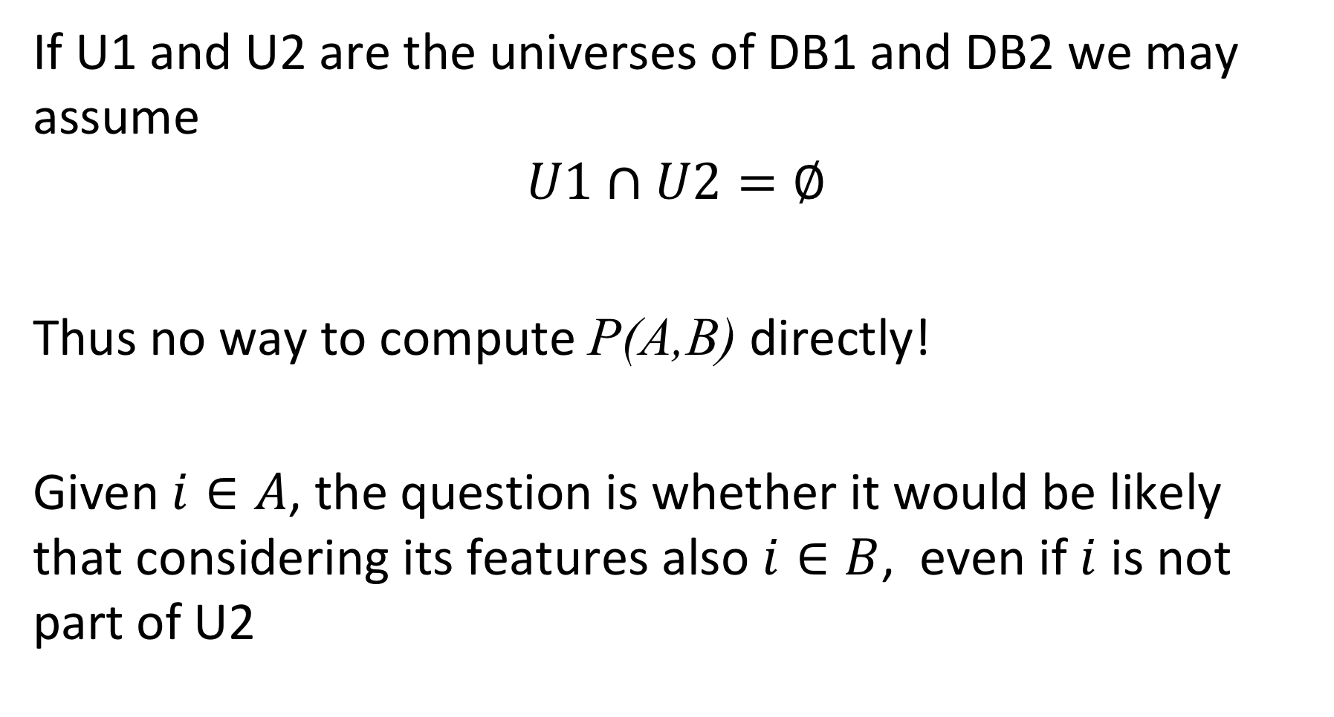
Finding Corresponding Classes
If U1 and U2 are the universes of DB1 and DB2 we may assume $$U1∩U2=∅$$
Thus no way to compute P(A,B) directly!
Given $i∈A$, the question is whether it would be likely that considering its features also $i∈B$, even if $i$ is not part of U2
Notes:
Even if we have identified features that can help to spot correspondences between structurally different, but semantically equivalent elements of two databases, it might be the case that the coverage of a real-world aspect in two databases is different (e.g. courses in two different universities). Thus, directly comparing the features (e.g. the instances of a class) does not help to detect the correspondences.

Slide 58
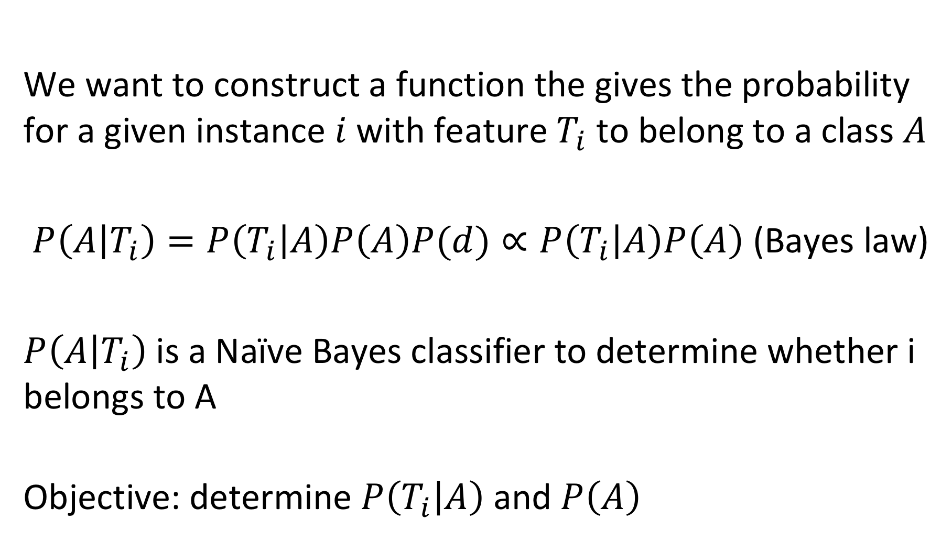
Probabilistic Approach
We want to construct a function the gives the probability for a given instance $i$ with feature $T_{i}$ to belong to a class $A$
$P\left(A | T_{i}\right)=P\left(T_{i} | A\right)P\left(A\right)P(d)∝P\left(T_{i} | A\right)P\left(A\right)$ (Bayes law)
$P\left(A | T_{i}\right)$ is a Naïve Bayes classifier to determine whether i belongs to A
Objective: determine $P\left(T_{i} | A\right)$ and $P\left(A\right)$
Notes:
To tackle the problem, we will construct a model that determines (probabilistically) whether a given data instance with certain features is semantically related to a class.

Slide 59
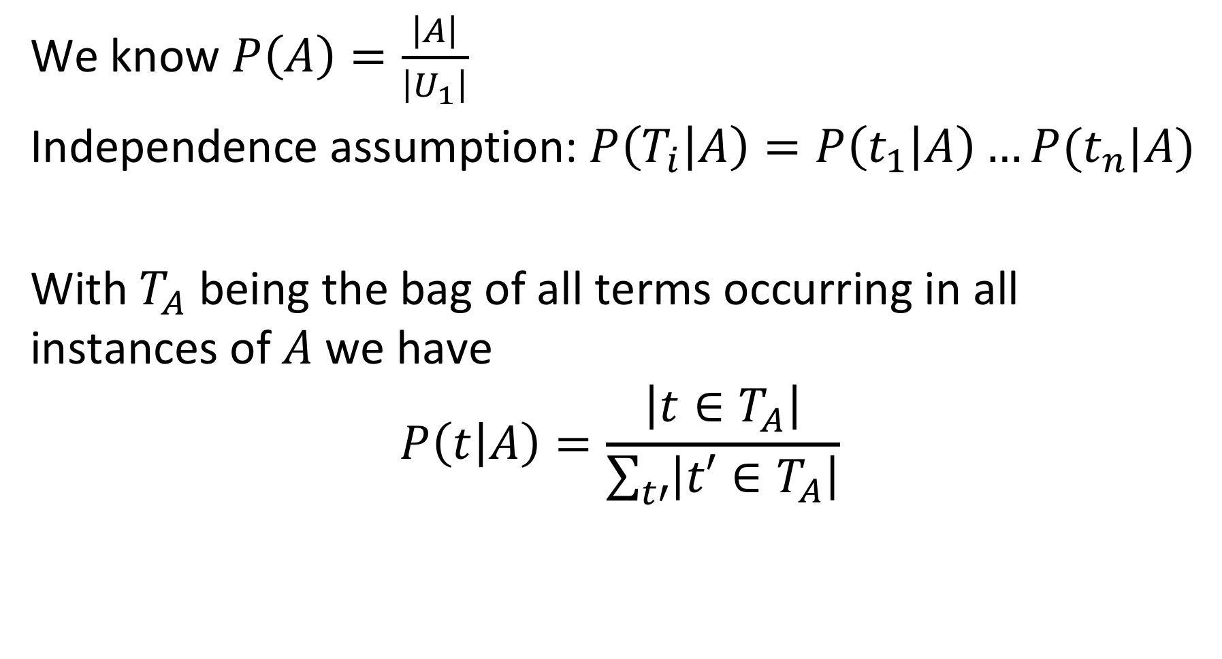
Naïve Bayes Classifier
We know $P\left(A\right)=\frac{\left|A\right|}{\left|U_{1}\right|}$
Independence assumption: $P\left(T_{i} | A\right)=P\left(t_{1} | A\right)…P(t_{n}|A)$
With $T_{A}$ being the bag of all terms occurring in all instances of $A$we have
$$P\left(t | A\right)=\frac{\left|t∈T_{A}\right|}{\sum_{t′}{\left|t′∈T_{A}\right|}}$$
Notes:
Computing P(A) is straightforward. We have just to determine the relative frequency of instances of A (how big A is) in the set of all possible instances.
For computing P(Ti | A) we first make an independence assumption: we assume that different terms occurring in the instance i of a class A are independent of each other. In practice this is not the case, but is a generally accepted assumption for simplicity. Then we have to compute the probability of a single term t in class A to occur.
By computing P(A) and P(Ti | A) we obtain (up to a constant) the probability of for a (new) instance I to belong to class A.

Slide 60
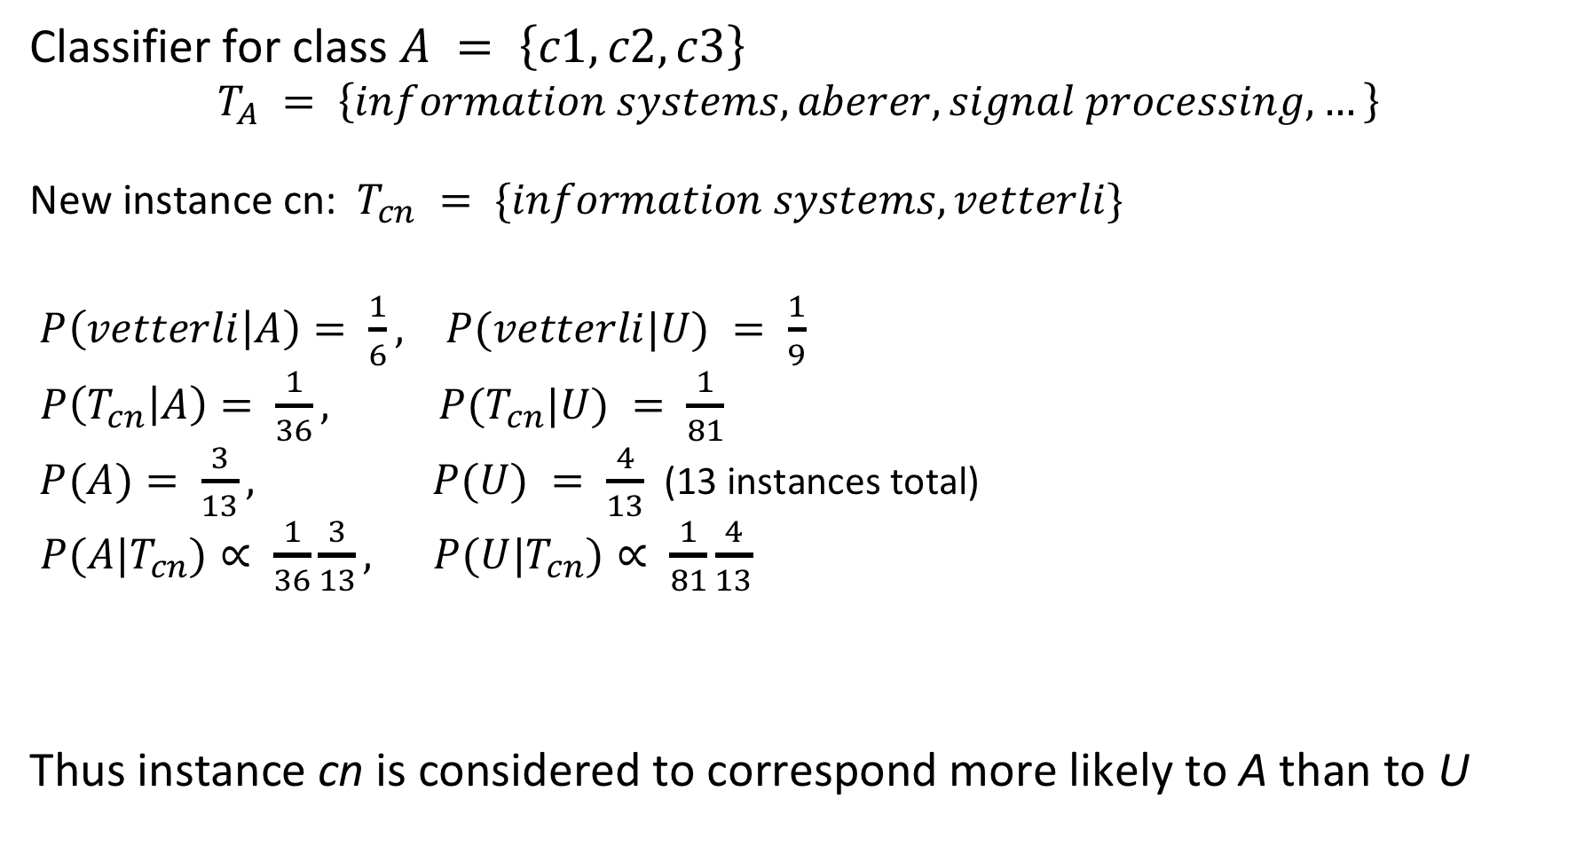
Example
Classifier for class $A = \left\{c1,c2,c3\right\}$
$$T_{A} = \left\{information systems, aberer, signal processing, …\right\}$$
New instance cn: $T_{cn} = \{information systems,vetterli\}$
$P\left(vetterli | A\right)= \frac{1}{6}, P(vetterli|U) = \frac{1}{9}$
$P\left(T_{cn} | A\right)= \frac{1}{36}, P(T_{cn}|U) = \frac{1}{81}$
$P(A)= \frac{3}{13}, P(U) = \frac{4}{13}$ (13 instances total)
$P(A|T_{cn})∝ \frac{1}{36}\frac{3}{13}, P(U|T_{cn})∝ \frac{1}{81}\frac{4}{13}$
Thus instance cn is considered to correspond more likely to A than to U
Notes:
We show here a complete example of how for a new instance $cn$, the most likely corresponding class can be determined in the database. The Naïve Bayes classifier assigns a higher probability for $cn$ to belong to A than to U (which coincides with our intuition).

Slide 61
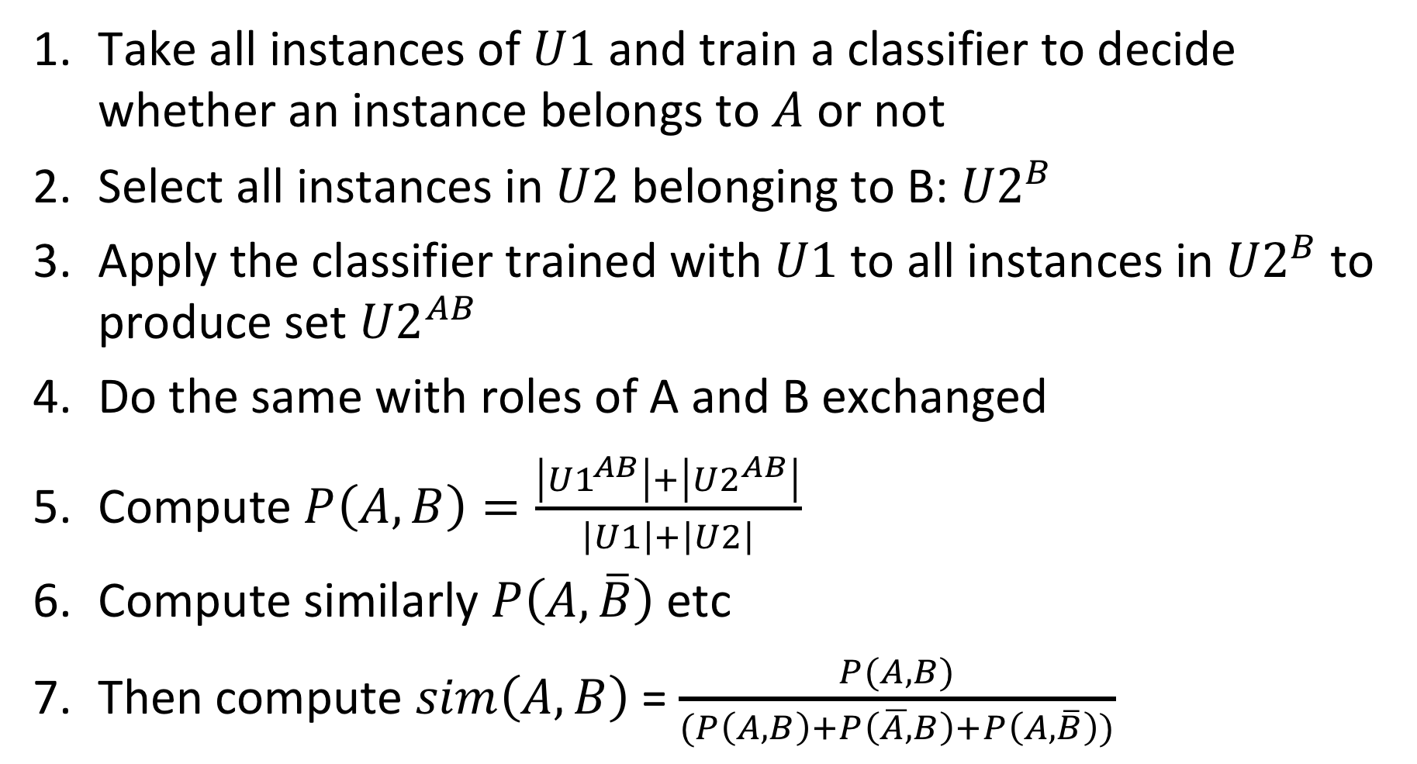
Computing Similarity between Classes A and B
Take all instances of $U1$ and train a classifier to decide whether an instance belongs to $A$ or not
Select all instances in $U2$ belonging to B: ${U2}^{B}$
Apply the classifier trained with $U1$to all instances in${ U2}^{B}$ to produce set ${U2}^{AB}$
Do the same with roles of A and B exchanged
Compute $P\left(A,B\right)=\frac{\left|{U1}^{AB}\right|+\left|{U2}^{AB}\right|}{\left|U1\right|+\left|U2\right|}$
Compute similarly $P\left(A,\overline{B}\right)$ etc
Then compute $sim\left(A,B\right)$ = $\frac{P(A,B)}{(P\left(A,B\right)+P\left(\overline{A,}B\right)+P\left(A,\overline{B}\right))}$
Notes:
For computing Jaccard similarity between two classes A and B we need to know how many elements are contained in the intersection of A and B and the union of A and B. To that end we can first separate in each of the two databases the elements that belong to the class present in the database (e.g. A in database D1 with universe U1), and then apply the classifier learnt from the other database, whether an element in each of those two sets belongs also to the other class, or not. We consider U2^{AB} as the set of elements of B that are likely to belong to A, if they where part of database D1. In this way we determine (or better estimate) the sizes of the potential intersection of A and B and the union of A and B and can based on this compute an estimate for Jaccard similarity.

Slide 62
Node Mapping
With the similarity values, alternative class mappings are possible
Naïve approach
Order matchings by probability
Choose the most probable matching and produce a mapping among the classes
Remove the mapped classes
Choose the next most probable matching and repeat
Drawback
Obvious consistency constraints may be violated, e.g., if all children of a class are mapped, then also their parent class should be mapped
Solution: more sophisticated mapping algorithms that incorporate such general and domain-specific constraints (research problem)
Notes:
Once the similarity values are computed the process of matching for establishing correspondences is completed. Now the problem of mapping remains, i.e. determine which classes should be considered as equivalent. This is in general not uniquely determined, since a class can be similar to several others. On the other hand we can assume that one class should only be mapped to exactly another class in the other database. This imposes a constraint on the mapping.
A simple approach to establish a mapping that observes this constraint is by proceeding in a greedy fashion. First the best matches are used to produce mappings, then the the mapped classes are removed (to assure that each class is mapped to a unique other class) and then the process continues.

Slide 63
References
Course material based on
Pershina, Maria, Yifan He, and Ralph Grishman. "Personalized page rank for named entity disambiguation." Proceedings of the 2015 Conference of the North American Chapter of the Association for Computational Linguistics: Human Language Technologies. 2015.
Talukdar, Partha Pratim, and Koby Crammer. "New regularized algorithms for transductive learning." Joint European Conference on Machine Learning and Knowledge Discovery in Databases. Springer, Berlin, Heidelberg, 2009.
Bordes, Antoine, et al. "Translating embeddings for modeling multi-relational data." Advances in neural information processing systems. 2013.
Nguyen, Dat Quoc. "An overview of embedding models of entities and relationships for knowledge base completion." arXiv preprint arXiv:1703.08098 (2017).
Doan, AnHai, et al. "Learning to map between ontologies on the semantic web." Proceedings of the 11th international conference on World Wide Web. ACM, 2002.

